Slide 1
CHEMISTRY 2e
Chapter 13 Fundamental Equilibrium Concepts
PowerPoint Image Slideshow

Slide 2
Chapter 13 Outline
13.1 Chemical Equilibrium
13.2 Equilibrium Constants
13.3 Shifting Equilibria: Le Châtelier’s Principle
13.4 Equilibrium Calculations

Slide 3
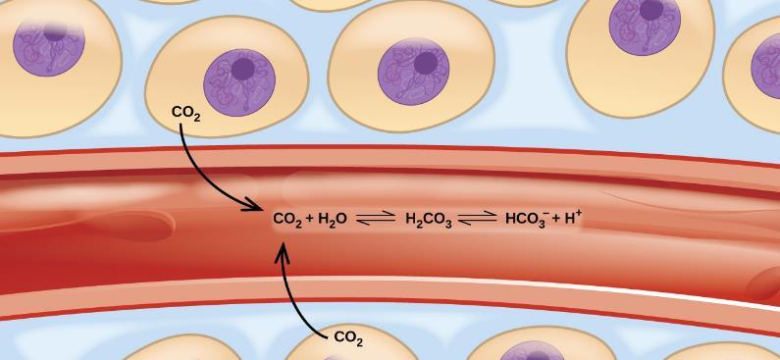
Figure 13.1
Transport of carbon dioxide in the body involves several reversible chemical reactions, including hydrolysis and acid ionization (among others).

Slide 4
Learning Objectives
13.1 Chemical Equilibria
Describe the nature of equilibrium systems
Explain the dynamic nature of a chemical equilibrium

Slide 5
Chemical Equilibria
Reactions with an appreciable reverse reaction are often best represented as an equilibrium.
$N_{2}O_{4}(g)$⇌$\text{ 2}\text{N}{\text{O}}_{2}(g)$

Slide 6
Chemical Equilibria
$N_{2}O_{4}(g)$⇌$\text{ 2}\text{N}{\text{O}}_{2}(g)$
N₂O₄ is colorless. NO₂ is brown.
When N₂O₄ is placed in a closed container at 100 °C, a reddish-brown color develops due to the formation of NO₂.
The forward reaction occurs.
As NO₂ builds up, it can react to form N₂O₄
The reverse reaction occurs.
At equilibrium, the amounts of reactants and products stop changing.

Slide 7
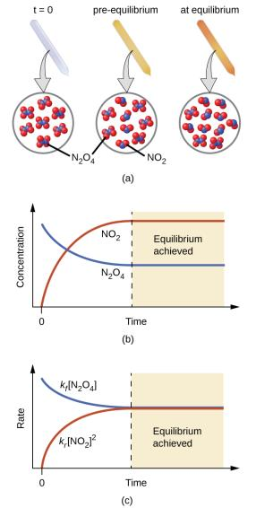
Figure 13.2
(a) A sealed tube containing colorless N2O4 darkens as it decomposes to yield brown NO2. (b) Changes in concentration over time as the decomposition reaction achieves equilibrium. (c) At equilibrium, the forward and reverse reaction rates are equal.

Slide 8
Establishment of Equilibrium
$$N_{2}O_{4}(g)\text{⇌}\text{2}\text{N}{\text{O}}_{2}(g)$$
The rate of the forward reaction starts out fast, but slows down as the concentration of N₂O₄ decreases.
The rate of the reverse reaction starts out slow, but speeds up as the concentration of NO₂ increases.
Once the rates of both reactions are equal, equilibrium is established.
No further changes in concentration of either gas occurs unless the temperature or the volume of the container is changed.

Slide 9
Common Equilibrium Misconceptions
The amount of reactants and products are ordinarily not equal to each other at equilibrium.
Although the amount of reactants and products remains constant at equilibrium, the system is not static at equilibrium.
Chemical equilibrium is a dynamic process.

Slide 10
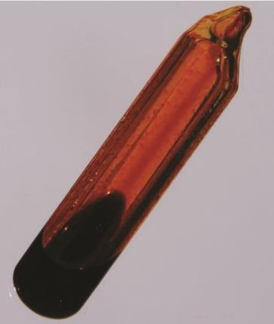
Figure 13.4
A sealed tube containing an equilibrium mixture of liquid and gaseous bromine. (credit: http://images-ofelements.com/bromine.php)

Slide 11
Learning Objectives
13.2 Equilibrium Constants
Derive reaction quotients from chemical equations representing homogeneous and heterogeneous reactions
Calculate values of reaction quotients and equilibrium constants, using concentrations and pressures
Relate the magnitude of an equilibrium constant to properties of the chemical system

Slide 12
Equilibrium Constants
The symbol $)$⇌ , placed between reactants and products, is used to designate reversible reactions.
The reaction quotient, Q, allows us to mathematically express the concentrations (or pressures) of reactants and products present at any point in a reversible reaction.

Slide 13

The Reaction Quotient, Q
Consider the general reaction:
A, B, C, D are either gases or aqueous species.
m, n, x, y are the coefficients in the balanced equation.
When using amounts expressed in concentration, the reaction quotient is called Qc.
$$m\text{A}\text{ + }n\text{B} ⇄ x\text{C}\text{ + }yD$$
$$Q_{C}\text{ = }\frac{[C]^{x}[D]^{y}}{[A]^{m}[B]^{n}}$$

Slide 14
The Concentration Reaction Quotient, Q_{c}
All concentrations must be expressed in Molarity.
Product concentrations are in the numerator (multiplied together).
Reactant concentrations are in the denominator (multiplied together).
Each concentration is raised to the power of its coefficient from the balanced equation.
Solids are always omitted from the expressions for Q and K!

Slide 15
Write the expression for the Qc for each equation.
(b) 4NH₃ (g) + 5O₂ (g) ⇌ 4NO(g) + 6H₂ O(g)
(c) N₂ O₄ (g) ⇌ 2NO₂ (g)
(d) CO₂ (g) + H₂ (g) ⇌ CO(g) + H₂O(g)
(e) NH4Cl(s) ⇌ NH₃ (g) + HCl(g)
(f) 2Pb(NO₃) ₂ (s) ⇌ 2PbO(s) + 4NO2 (g) + O2 (g)

Slide 16
The Value of the Reaction Quotient, Q
The numeric value of Q_{c} for a given reaction can vary prior to equilibrium.
The value of Q_{c} depends on the concentration of products and reactants present at that particular moment.
We can calculate Q_{c} at any point in a reaction.
We will often calculate Q_{c} at the start of the reaction using initial concentrations.

Slide 17
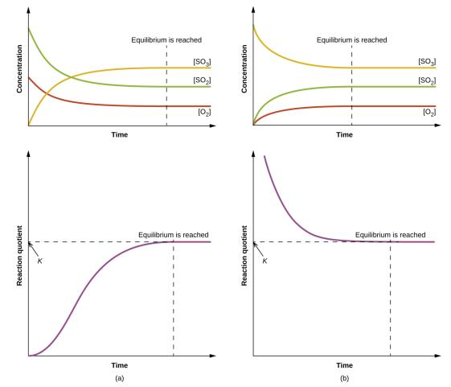
Figure 13.5
Changes in concentrations and Qc for a chemical equilibrium achieved beginning with a (a) mixture of reactants only and (b) products only.

Slide 18
The Equilibrium Constant, K
The value of Q when the reaction is at equilibrium is called the equilibrium constant (K).
Be careful not confuse with the kinetic rate constant (k).
$$\text{aA}\text{ + }\text{bB} ⇄ \text{cC}\text{ + }\text{dD}$$
$$Q_{C} \text{at} \text{equilibrium}\text{ = }K_{c}=\frac{[C]^{c}[D]^{d}}{[A]^{a}[B]^{b}}$$

Slide 19
Q and K
$$\text{aA}\text{ + }\text{bB} ⇄ \text{cC}\text{ + }\text{dD}$$
The equilibrium constant (K) has the same form as the reaction quotient (Q).
For K, the concentrations must be those at equilibrium.
For Q, the concentrations can be those at any point in the reaction, not necessarily when at equilibrium.
$$Q_{C}\text{ = }\frac{[C]^{c}[D]^{d}}{[A]^{a}[B]^{b}} K_{c}=\frac{[C]^{c}[D]^{d}}{[A]^{a}[B]^{b}}$$

Slide 20
The Equilibrium Constant, K
The value of the equilibrium constant is independent of the starting amounts of reactants and products.
The value of the equilibrium constant is dependent on the temperature of the system.
ONLY a change in temperature can change the value of the equilibrium constant!
K and Q are unitless values.
The magnitude of an equilibrium constant indicates the extent of a reaction.

Slide 21
The Magnitude of the Equilibrium Constant
If K is very small, the mixture contains mostly reactants at equilibrium.
If K is very large, the mixture contains mostly products at equilibrium.
The value of K gives no indication as to whether the reaction is fast or slow.

Slide 22

Q, K, and the Direction of Reaction
$$\text{aA}\text{ + }\text{bB} \underset{⇇}{ } \text{cC}\text{ + }\text{dD}$$
A system that is not at equilibrium will proceed in the direction that establishes equilibrium.
By comparing Q to K, it is possible to determine which direction the system will proceed to achieve equilibrium.
$$Q_{C}\text{ = }\frac{[C]^{c}[D]^{d}}{[A]^{a}[B]^{b}}$$

Slide 23
Q, K, and the Direction of Reaction
$$\text{aA}\text{ + }\text{bB} ⇄ \text{cC}\text{ + }\text{dD}$$
When Q < K Reaction must shift FORWARD
When Q > K Reaction must shift BACKWARD
When Q = K Reaction is at equilibrium, and will maintain
Constant concentration
$$Q_{C}\text{ = }\frac{[C]^{c}[D]^{d}}{[A]^{a}[B]^{b}}$$

Slide 24
Changes in Reactant and Product Concentrations
There are many ways to approach the equilibrium state.
Mixture 1: Start with just CO and H₂O.
Mixture 2: Start with just CO₂ and H₂.
Mixture 3: Start with CO, H₂O, CO₂, and H₂.
The value of the equilibrium constant is independent of the starting amounts of the reactants and products.
If the reaction initially contained 4.0 M CO, and 2.0 M H2 only, what would happen?
$$\text{CO}(g)\text{ + }{\text{H}}_{2}O(g) \underset{⇇}{ } \text{C}{\text{O}}_{2}(g)\text{ + }{\text{H}}_{2}(g)$$

Slide 25
Homogenous Equilibrium
A homogenous equilibrium is one in which all of the reactants and products are present in the same phase.
Most commonly are either liquid or gaseous phases.
Reaction quotients include concentration or pressure terms only for gaseous and solute species.
For gas-phase solutions, the equilibrium constant may be expressed in terms of either the molar concentrations (K_{c}) or partial pressures (K_{p}) of the reactants and products.

Slide 26
Homogenous Equilibria
$$\text{HF}(aq)\text{ + }{\text{H}}_{2}O(l) ⇄ {\text{H}}_{3}O^{+}(aq)\text{ + }{\text{F}}^{–}(aq)$$
$$Kc=\frac{{[H}_{3}O^{+}][F^{−}]}{[HF]}$$
$$C_{2}H_{6}(g)⇄{\text{C}}_{2}H_{4}(g)\text{ + }{\text{H}}_{2}(g)$$
$$Kp=\frac{(P_{C_{2}H_{4}})(P_{H_{2}})}{P_{C_{2}H_{6}}}$$
NOTE: In the Kc, we MUST use brackets. [ ] not ( )
In the Kp we must NOT use brackets!!!

Slide 27

K_{c} and K_{p}
For gas-phase solutions, the equilibrium constant may be expressed in terms of either the molar concentrations (K_{c}) or partial pressures (K_{p}) of the reactants and products.
A relation between these two K values may be simply derived from the ideal gas equation and the definition of molarity:
$$PV=nRT \\ P=\left(\frac{n}{V}\right)RT \\ = MRT$$

Slide 28
K_{c} and K_{p}
The relationship between K_{c} and K_{p}:
Δn is the change in the number of moles of gas.
R = 0.08206 L ∙ atm/mol ∙ K
T is temperature in Kelvin.
$$K_{p}=K_{c}(RT)^{Δn}$$
Solve the following problem:
H₂(g) + Cl₂(g) ⇌ 2 HCl(g)
At 1000 K, the Kc for this reaction is found to be
6.00 x 10⁶ . What is the value of the Kp at that T ?

Slide 29
Did you get the answer, 6.00 x 10⁶ ? Did you waste a lot of time on it?
If the sum of the exponents in the numerator = the sum of the exponents in the denominator, then Δn is 0.
In that case Kc = Kp.

Slide 30
Heterogeneous Equilibrium
Some reaction mixtures contain reactants and products that are in two or more different phases. These systems are called heterogeneous equilibria.
Pure solids and pure liquids do not appear in the K expression.
The position of equilibrium is independent of the amount of solid or liquid present, as long as at least some is present in the reaction mixture.
$$\text{N}{\text{H}}_{4}\text{Cl}(s) \underset{⇇}{ } \text{N}{\text{H}}_{3}(g)\text{ + }\text{HCl}(g)$$

Slide 31
Learning Objectives
13.3 Shifting Equilibria: Le Châtelier’s Principle
Describe the ways in which an equilibrium system can be stressed
Predict the response of a stressed equilibrium using Le Chatelier’s principle

Slide 32
Shifting Equilibria: Le Châtelier’s Principle
Le Châtelier’s Principle: When a chemical system at equilibrium is disturbed, it returns to equilibrium by counteracting the disturbance.
At equilibrium Q = K.
The disturbance causes a change in Q.
The reaction will shift to re-establish Q = K.
In the case of a temperature change, the disturbance changes the value of K. The direction of that change depends on whether the reaction is exothermic or endothermic.

Slide 33
Adding or Removing a Reactant or Product
If a chemical equilibrium is disturbed by adding a reactant or product, the system will proceed in the direction that consumes part of the added species.
If a chemical equilibrium is disturbed by removing a reactant or product, the system will proceed in the direction that restores part of the removed species.
The system responds in the way that restores equilibrium and therefore allows Q = K again.
If what is added or removed is a SOLID, the reaction does not shift at all!!! However, while the amount of solid does not affect the equilibrium, any shift in equilibrium DOES change the amount of solid.

Slide 34
Adding or Removing a Pure Liquid or Solid
Adding or removing a pure liquid or solid has no effect on the system unless all of the liquid or solid is removed.
This is because pure liquids and solids do not appear in the equilibrium expression.

Slide 35
Temperature and the Equilibrium Constant
E
X othermic
Changing the temperature of a system results in a change in the value of the equilibrium constant.
If the forward reaction is exothermic, then K decreases as T increases.
If the forward reaction is endothermic, then K increases as T increases.
K
T
Silly mnemonic, on the “X” in “exo.” As T goes up, K goes down. JUST KNOW IT!!

Slide 36
Summarizing factors that shift equilibria.
Adding more reactant (but not solids!) will cause the reaction to shift so as to use that reactant up. The product concentration will INCREASE, as reactant decreases. Reaction shifts FORWARD. K does NOT change. Adding more product will have the OPPOSITE impact.
Adding more reactant will Decrease the value of Q. When Q,<K, reactions shift so as to produce product.
Removing reactant has the OPPOSITE effect. Reaction shifts left.
Adding product INCREASES Q. Reaction shifts to form more reactant.
Removing product has the same effect as adding reactant. (why?)

Slide 37
Effect of Temperature
An increase in temperature will change K. It will INCREASE K for an endo, and DECREASE K for an exo.
It will shift the reaction so as to favor whichever direction is ENDOthermic.
A decrease in temperature will also change K. It will Increase K for an exo, and decrease K for an endo.
It will shift the reaction so as to favor the EXOthermic direction.
Effect of a change in volume.
A decrease in volume will shift the equilibrium so as to produce FEWER moles of gas. It will NOT change K.

Slide 38
N_{2(g)} + 3 H₂(g) ⇌ 2 NH₃(g)
ΔH° = -92kJ/mol rxn
If additional hydrogen is added to the mixture at equilibrium,
A) the conc. Of N_{2(g) ________}
B) the conc. of NH₃(g) ______
C) the value of Keq _________
The volume of the system is decreased.
A) the amount of N_{2(g) ________}
B) the amount of NH₃(g) ______
C) the value of Keq _________
3. How are those 3 variables affected if T inc?

Slide 39
Catalysts do not Affect Equilibrium
A catalyst speeds up the rate of a reaction.
For reversible reactions, catalysts increase the rates of the forward and reverse reactions.
Result: A catalyst causes the system to reach equilibrium more quickly.
But a catalyst does not affect the equilibrium concentrations or value of the equilibrium constant.
And what is the ONLY thing that will change that value???

Slide 40
Learning Objectives
13.4 Equilibrium Calculations
Identify the changes in concentration or pressure that occur for chemical species in equilibrium systems
Calculate equilibrium concentrations or pressures and equilibrium constants, using various algebraic approaches

Slide 41
Equilibrium Calculations
Types of Equilibrium Calculations:
Calculation of an equilibrium constant
Calculation of missing equilibrium concentration or partial pressure
Calculation of equilibrium concentrations (or partial pressures) from initial concentrations (or partial pressures)

Slide 42
Manipulating Equilibrium Constants
The equilibrium constant of a reaction in the reverse reaction is the reciprocal of the equilibrium constant of the forward reaction:
[NO₂]²
[N₂O₄]
N₂O₄(g)
2NO₂(g)
K_{c} = = 0.212 at 100 °C
[N₂O₄]
[NO₂]²
2NO₂(g)
N₂O₄(g)
K_{c} = = 4.72 at 100 °C
© 2012 Pearson Education, Inc.

Slide 43
Manipulating Equilibrium Constants
The equilibrium constant of a reaction that has been multiplied by a number is the equilibrium constant raised to a power that is equal to that number:
[NO₂]²
[N₂O₄]
N₂O₄(g)
2NO₂(g)
K_{c} = = 0.212 at 100 °C
[NO₂]⁴
[N₂O₄]²
2N₂O₄(g)
4NO₂(g)
K_{c} = = (0.212)² at 100 °C
© 2012 Pearson Education, Inc.

Slide 44
Manipulating Equilibrium Constants
The equilibrium constant for a net reaction made up of two or more steps is the product of the equilibrium constants for the individual steps.
Practice Exercise 1. For the reaction
For ,
K_{p} = 4.34 × 10⁻³ at 300 °C .What is the value of K_{p} for the reverse reaction?
© 2012 Pearson Education, Inc.

Slide 45
Sample Exercise 15.5 Combining Equilibrium Expressions
Given the reactions
determine the value of K_{c} for the reaction
Solution
Analyze We are given two equilibrium equations
and the corresponding equilibrium constants and are
asked to determine the equilibrium constant for a
third equation, which is related to the first two.
Plan We cannot simply add the first two equations to get the third. Instead, we need to determine how to manipulate the equations to come up with the steps that will add to give us the desired equation.
Notes:
45

Slide 46
Sample Exercise 15.5 Combining Equilibrium Expressions
Continued
Solve
If we multiply the first equation by 2 and make the corresponding change to its equilibrium constant (raising to the power 2), we get
Reversing the second equation and again making the corresponding change to its equilibrium constant (taking the reciprocal) gives
Now we have two equations that sum to give the net equation, and we can multiply the individual K_{c} values to get the desired equilibrium constant.
Notes:
46

Slide 47
Sample Exercise 15.5 Combining Equilibrium Expressions
Continued
Practice Exercise
Given that, at 700 K, Kp = 54.0 for the reaction and K_{p} = 1.04 × 10⁻⁴ for the reaction
, determine the value of K_{p} for the reaction 6 HI(g) + N₂(g) at 700 K.
Answer:
Notes:
47

Slide 48
1, Answer: 2.30 × 10²
2.

Slide 49
Solving Equilibrium Problems.
All equilibrium problems require the correct expression for K (or Q).
They can be divided into 4 types. Two are very easy, the third more complicated, the fourth more complicated, but unfortunately, more common.
1. All concentrations (or pressures ) are given, find K.
Simply substitute the given values into the equilibrium expression.

Slide 50
Sample Exercise 15.8 Calculating K When All Equilibrium Concentrations Are Known
After a mixture of hydrogen and nitrogen gases in a reaction vessel is allowed to attain equilibrium at 472 °C, it is found to contain 7.38 atm H₂, 2.46 atm N₂, and 0.166 atm NH₃. From these data, calculate the equilibrium constant K_{p} for the reaction
Solution
Analyze We are given a balanced equation and equilibrium partial pressures and are asked to calculate the value of the equilibrium constant.
Plan Using the balanced equation, we write the equilibrium-constant expression. We then substitute the equilibrium partial pressures into the expression and solve for K_{p}.
Solve
Practice Exercise
An aqueous solution of acetic acid is found to have the following equilibrium concentrations at 25 °C:
[CH₃COOH] = 1.65 × 10⁻² M; [H⁺] = 5.44 × 10⁻⁴ M; and [CH₃COO⁻] = 5.44 × 10⁻⁴ M. Calculate the equilibrium constant K_{c} for the ionization of acetic acid at 25 °C. The reaction is
Notes:
50

Slide 51
Type 2. K is given. All but one of the equilibrium concentrations are given, find the other one.

Slide 52
Type 2. Calculating Equilibrium Concentrations when K and all but one of them is known
For the Haber process, , K_{p} = 1.45 × 10⁻⁵ at 500 °C. In an equilibrium mixture of the three gases at 500 °C, the partial pressure of H₂ is 0.928 atm and that of N₂ is 0.432 atm. What is the partial pressure of NH₃ in this equilibrium mixture?
Solution
Analyze We are given an equilibrium constant, K_{p}, and the equilibrium partial pressures of two of the three substances in the equation (N₂ and H₂), and we are asked to calculate the equilibrium partial pressure for the third substance (NH₃).
Solve We tabulate the equilibrium pressures:
Because we do not know the equilibrium pressure of
NH₃, we represent it with x. At equilibrium the
pressures must satisfy the equilibrium-constant
expression:
We now rearrange the equation to solve for x:
Plan We can set K_{p} equal to the equilibrium-constant
expression and substitute in the partial pressures that we know. Then we can solve for the only unknown in the equation.
Notes:
52

Slide 53
Practice Exercise
At 500 K the reaction
has K_{p} = 0.497. In an equilibrium mixture at 500 K, the partial pressure of PCl₅ is 0.860 atm and that of PCl₃ is 0.350 atm. What is the partial pressure of Cl₂ in the equilibrium mixture?
Answer: 1.22 atm
PCl_{5(g)} ⇌ PCl_{3(g)} + Cl_{2(g)}

Slide 54
TYPE 3 Finding K, when all the initial concentrations are known, and ONE equilibrium concentration is given.
It is necessary to set up a reaction table, sometimes called an “ICE chart” to find ALL the equilibrium concentrations. THEN, you can put those values into the equilibrim equation to find K. (See also, problem 13.7 in text)

Slide 55
An Equilibrium Problem
A closed system initially containing 1.000 x 10⁻³ M H₂ and 2.000 x 10⁻³ M I₂ at 448 °C is allowed to reach equilibrium. Analysis of the equilibrium mixture shows that the concentration of HI is 1.87 x 10⁻³ M. Calculate K_{c} at 448 °C for the reaction taking place, which is
H₂(g) + I₂(g)
2HI(g)
© 2012 Pearson Education, Inc.

Slide 56
Below is an ICE chart for this reaction. I normally include the coefficients.
 | [H₂], M | [I₂], M | 2 [HI], M
Initially | 1.000 x 10⁻³ | 2.000 x 10⁻³ | 0
Change
At equilibrium |  |  | 1.87 x 10⁻³

Slide 57
[HI] Increases by 1.87 x 10⁻³ M
 | [H₂], M | [I₂], M | 2 [HI], M
Initially | 1.000 x 10⁻³ | 2.000 x 10⁻³ | 0
Change |  |  | +1.87 x 10⁻³
At equilibrium |  |  | 1.87 x 10⁻³
© 2012 Pearson Education, Inc.

Slide 58
We can now calculate the equilibrium concentrations of all three compounds
 | [H₂], M | [I₂], M | 2[HI], M
Initially | 1.000 x 10⁻³ | 2.000 x 10⁻³ | 0
Change | −9.35 x 10⁻⁴ | −9.35 x 10⁻⁴ | +1.87 x 10⁻³
At equilibrium | 6.5 x 10⁻⁵ | 1.065 x 10⁻³ | 1.87 x 10⁻³
© 2012 Pearson Education, Inc.

Slide 59
and, therefore, the equilibrium constant:
[HI]²
[H₂] [I₂]
K_{c} =
(1.87 x 10⁻³)²
(6.5 x 10⁻⁵)(1.065 x 10⁻³)
=
= 51
© 2012 Pearson Education, Inc.

Slide 60
TYPE FOUR. K is known, initial conc. are known, find one or more FINAL concentration.
Example 13.9 in text, with a different given value of K.
At a certain temperature, Kc is 2.1 x 10⁻⁴ for this reaction.
If the initial [PCl_{5(g)} is 1.00 molar, with no products present, what are the equilibrium concentrations of the three components?
PCl_{5(g)} ⇌ PCl_{3(g)} + Cl_{2(g)}

Slide 61
PCl_{5(g)} ⇌ PCl_{3(g)} + Cl_{2(g)} Let x = change in PCl₅
Initial 1.00 0 0
Change -x +x +x
Equilibrium 1.00-x x x
Plugging into the expression for K gives us
_{x}²/(1-x) = 2.1 x 10⁻⁴ Quadratic. BUT…….
Since K is small, very little product is formed. Let’s assume that
x is very small compared to 1.00. We are saying 1-x ≈1.
X = 0.014 So at equilibrium, the concentrations are
0.99, 0.014, and 0.014. Were we right to say that 1-x = 1?
The usual guideline is that “x” should not change the . of reactant by more than 5 %.
If you look at the problem in the text, the K was much higher, so
this “simplifying assumption” produces a small error
x
Page 746 in text, example 13.9

