Slide 1
CHEMISTRY 2e
Chapter 14 Acid-Base Equilibria
PowerPoint Image Slideshow

Slide 2
Chapter Outline
14.1 Brønsted-Lowry Acids and Bases
14.2 pH and pOH
14.3 Relative Strengths of Acids and Bases
14.4 Hydrolysis of Salts
14.5 Polyprotic Acids
14.6 Buffers
14.7 Acid-Base Titrations

Slide 3
Learning Objectives
14.1 Brønsted-Lowry Acids and Bases
Identify acids, bases, and conjugate acid-base pairs according to the Brønsted-Lowry definition
Write equations for acid and base ionization reactions
Use the ion-product constant for water to calculate hydronium and hydroxide ion concentrations
Describe the acid-base behavior of amphiprotic substances

Slide 4
Acid and Base Definitions
Johannes Brønsted and Thomas Lowry (1923) definition:
Focused on the reactions that take place between acids and bases.
Brønsted-Lowry Acid: A compound that donates a proton to another compound.
Brønsted-Lowry Base: A compound that accepts a proton from another compound.
Note that both of these are FUTURE tense.
It is an acid BEFORE it donates.
NH3 + H2O → NH4⁺ + OH-
The NH3 is the base here because it WILL accept a proton from the H2O, which is the acid that will donate it.

Slide 5
What Types of Compounds are Acids and Bases?
Acids:
Molecules: Both organic and inorganic
Cations that contain H
Anions that contain H

Slide 6
What Types of Compounds are Acids and Bases?
Bases:
Ionic compounds that contain OH- NaOH, Ca(OH)₂
Molecules - Primarily amines ( contain a C-NH2 bond)
Anions – With and without H ( F-. CO₃²⁻)

Slide 7
Brønsted-Lowry Acid/Base Theory
The species formed when a proton is removed from an acid is the conjugate base of that acid.
The species formed when a proton is added to a base is the conjugate acid of that base.

Slide 8
Amphiprotic Species
A species that can either accept or donate a proton is called amphiprotic.
An amphiprotic species can serve as an acid or a base.
Example: Water
In the presence of an acid, water acts as a base.
In the presence of a base, water acts like an acid.
Anions with a removable H+ are amphiprotic.
HCO₃⁻for example, could gain or lose an H+

Slide 9
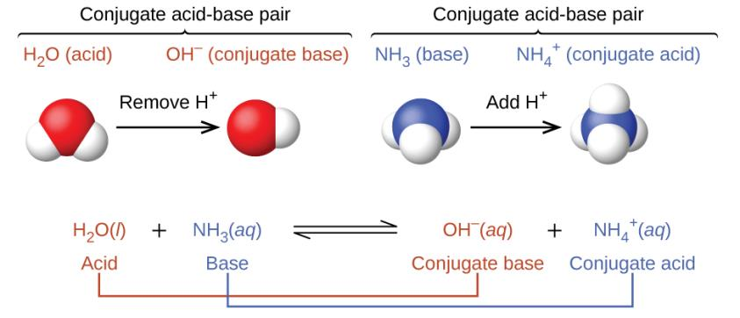
UNFIGURE 14.1
The acid and its conjugate base always differ by a single H+. The ACID has the extra H+, and always a charge 1 higher than that of the conjugate base.
(see text question 9, page 814)

Slide 10
Water as a Base
The reaction between a Brønsted-Lowry Acid and water is called acid ionization.

Slide 11
UNFIGURE 14.2

Slide 12
Water as an Acid
The reaction between a Brønsted-Lowry Base and water is called base ionization.

Slide 13
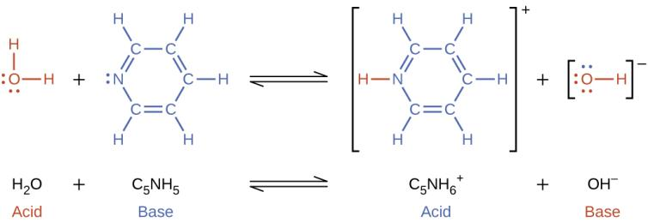
UNFIGURE 14.3

Slide 14
The Autoionization of Water
In pure water, water also acts both as an acid and a base.
Autoionization of water:
The equilibrium constant for this reaction is called the ion product constant for water, K_{w}.
At 25 °C, K_{w} = 1.0 × 10^{–14}
The Kw, with its value of 1.0 × 10^{–14}at room temperature is important enough to memorize!

Slide 15
UNFIGURE 14.4

Slide 16
Learning Objectives
14.2 pH and pOH
Explain the characterization of aqueous solutions as acidic, basic, or neutral
Express hydronium and hydroxide ion concentrations on the pH and pOH scales
Perform calculations relating pH and pOH

Slide 17
pH and pOH
K_{w} = [H₃O⁺][OH–]
In pure water,
When the concentration of [H₃O⁺] and [OH–] are equal, the solution is said to be neutral

Slide 18
H₃O⁺ and OH– Concentration
In pure water, [H₃O⁺] and [OH–] are equal to each other.
When an acid or base is dissolved in water, [H₃O⁺] and [OH–] are not equal to each other.
K_{w} = [H₃O⁺] [OH–] = 1.0 × 10^{–14}
[H₃O⁺] and [OH–] are inversely related to each other.
If [H₃O⁺] > 1.0 × 10^{–7}, then [OH–] < 1.0 × 10^{–7} and the solution is called acidic.
If [OH–] > 1.0 × 10⁻⁷, then [H₃O⁺] < 1.0 × 10^{–7} and
the solution is called basic.

Slide 19
pH
The acidity and basicity of a solution can be expressed in terms of its [H₃O⁺] or [OH–].
These concentrations can span many orders of magnitude, therefore logarithmic values are commonly used.
pH is defined as -log [H+]. pOH is – log [OH-].
[H+][OH-] = 1.0 x 10⁻¹⁴ Now taking the log of both sides gives us
Log[H+] + Log [OH-] = -14. Multiply by -1, and
-log[H+] - Log [OH-] = 14. But – log{H+] is pH!
So, pH + p OH MUST = 14 (at room temp.)

Slide 20
pH and pOH in a Neutral Solution
If [H₃O⁺] = [OH–] = 1.0 × 10^{–7} then the solution is considered neutral.
At room temperature.
Like ANY equilibrium constant, the Kw is temperature dependent. Since ionization is ENDOTHERMIC, the Kw increases as temperature increases.
If the Kw is NOT 1.0x10⁻¹⁴ , then the pH of a neutral solution will NOT be 7.
Problem 16 from text, p 815. The ionization constant (Kw) for water is 2.9 x 10⁻¹⁴ at 40º C. Find the pH, pOH, [H+] and [OH-] for pure water at that temperature.
Remember [H+] must be EQUAL to [OH-] in pure water at ANY temperature. [H+][OH-] = 2.9 x 10⁻¹⁴

Slide 21
If we call the[H+] “x”, then [OH-] is ALSO [x] , so the equation becomes
X² = 2.9 x 10⁻¹⁴ Then x = {H+] = [OH-] = 1.7 x 10⁻⁷ The pH is 6.77. The pOH must ALSO be 6.77
Should we call this solution acidic, because its pH is < 7 ? NO! An acidic solution must have [H+] > [OH-] If they are equal, the solution is neutral.
However, at ROOM TEMPERATURE, that pH will = 7.

Slide 22
pH and pOH in an Acidic Solution
If [H₃O⁺] > 1.0 × 10^{–7}, then [OH–] < 1.0 × 10^{–7} and the solution is considered acidic.
This is ONLY true at room temperature!!! However, we assume that the system is at 25ºC, and that Kw is 1.0 x 10⁻¹⁴ unless we are TOLD otherwise.

Slide 23
pH and pOH in a Basic Solution
If [OH–] > 1.0 × 10^{–7}, then [H₃O⁺] < 1.0 × 10^{–7} and the solution is considered basic.
AT ROOM TEMPERATURE!

Slide 24
Table 14.1 Summary of Relations for Acidic, Basic, and Neutral Solutions
Classification | Relative Ion Concentrations | pH at 25 °C
acidic | [H₃O⁺] > [OH–] | pH < 7
neutral | [H₃O⁺] = [OH–] | pH = 7
basic | [H₃O⁺] < [OH–] | pH > 7

Slide 25
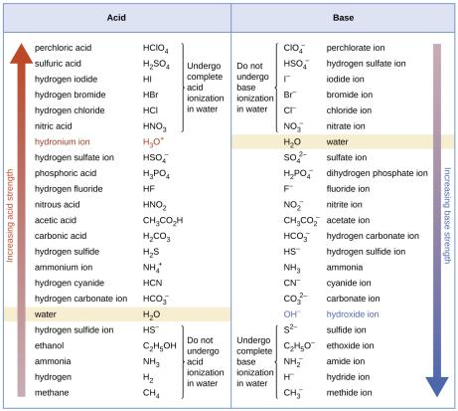
Figure 14.2
The pH and pOH scales represent concentrations of H₃O⁺ and OH⁻, respectively. The pH and pOH values of some common substances at 25 °C are shown in this chart.

Slide 26
pH of Strong Acid Solutions
Recall from Chapter 4 that some acids are strong.
HCl, HBr, HI, HClO₄, HNO₃, H₂SO₄
These acids essentially react completely with water.
Example: HCl
Bases such as NaOH, KOH, LiOH, Ca(OH)₂, Ba (OH)₂ will also dissociate completely when dissolved.
Chapter 14, problem 18 (like 19, which is homework!) ask you to find the pH (and pOH) of the following solutions
A . 0.200 M HCl. Since HCl is strong, we assume that it ALL ionizes, so the [H+] = 0.200, and the pH is 0.699 (pOH- 13.301)
B. 0.0143 M NaOH. Similarly, we assume [OH-] = 0.0143. pH=12.155
C. 3.0 M HNO₃ pH = -.48 Can pH be - ?
D. 0.0031 M Ca(OH)₂ pH = 11.79.

Slide 27
pH of Strong Bases
Recall as well that some bases are strong:
LiOH, NaOH, KOH, Ca(OH)₂, Sr(OH)₂, Ba(OH)₂
These bases dissociate completely into OH–.

Slide 28
Learning Objectives
14.3 Relative Strengths of Acids and Bases
Assess the relative strengths of acids and bases according to their ionization constants
Rationalize trends in acid–base strength in relation to molecular structure
Carry out equilibrium calculations for weak acid–base systems

Slide 29
Relative Strengths of Acids and Bases
Brønsted-Lowry Acids are H⁺ donors.
The strength of an acid is measured by the extent to which it forms H₃O⁺ in water.
HA_{(aq)} + H₂O_{(l)} ⇌ H₃O⁺_{(aq)} + A– _{(aq)}
Strong acids yield nearly 100% H₃O⁺.
Weak acids yield much less than 100% H₃O⁺.

Slide 30
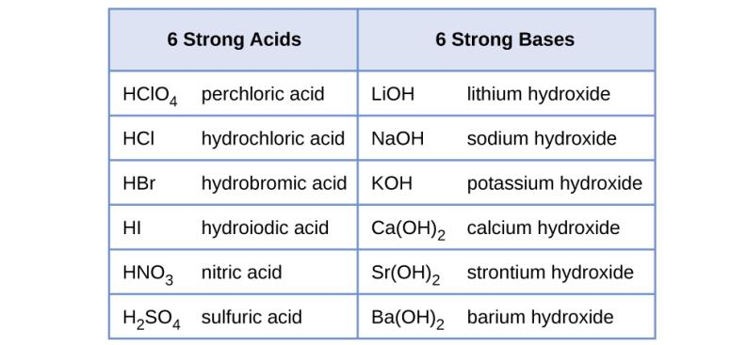
Figure 14.6
Some of the common strong acids and bases are listed here.

Slide 31
Acid-Ionization Constant, K_{a}
The relative strengths of weak acids can be determined by measuring their equilibrium constants.
The equilibrium constant for an acid is called the acid-ionization constant (K_{a}).
HA_{(aq)} + H₂O_{(l)} ⇌ H₃O⁺_{(aq)} + A –_{(aq)}
Or HA ⇌ H⁺ + A⁻
So the expression for the Ka is
$$Ka= \frac{{[H}^{+}][A^{−}]}{[HA]}$$

Slide 32
Acid-Ionization Constant, K_{a}
HA_{(aq)} + H₂O_{(l)} ⇌ H₃O⁺_{(aq)} + A –_{(aq)}
K_{a} values are related to the strength of the acid.
The larger the K_{a} of an acid the stronger the acid
The smaller the K_{a} of an acid the weaker the acid.
But, since $Ka= \frac{{[H}^{+}][A^{−}]}{[HA]}$ in a strong acid, where the molarity of HA
Approaches ZERO, the value of Ka becomes very, very large. It is usually not even measured, as we assume that [HA] becomes close to 0.

Slide 33
Relative Strength of Bases
Brønsted-Lowry Bases are H⁺ acceptors.
The strength of a base is measured by the extent to which it forms hydroxide ions in water.
B_{(aq)} + H₂O_{(l)} ⇌ HB⁺_{(aq)} + OH–_{(aq)}
Strong bases yield nearly 100% OH–.
Weak bases yield much less than 100% OH–.

Slide 34
Base-Ionization Constant, K_{bB}
The relative strengths of weak bases can be determined by measuring their equilibrium constants.
The equilibrium constant for a base is called the base-ionization constant (K_{b}).
B_{(aq)} + H₂O_{(l)} ⇌ HB⁺_{(aq)} + OH–_{(aq)}
$Kb= \frac{[HB^{+}] ][{OH}^{−}]}{[B]}$ more often, the base is a negative ion, and
this expression becomes $Kb= \frac{[HB] ][{OH}^{−}]}{[B−]}$

Slide 35
Base-Ionization Constant, K_{b}
B_{(aq)} + H₂O_{(l)} ⇌ HB⁺_{(aq)} + OH–_{(aq)}
K_{b} values are related to the strength of the base.
The larger the K_{b} of the base the stronger the base,
The smaller the K_{b} of the base the weaker the base

Slide 36
Acid/Base Strength Notes
K_{a} and K_{b} are inversely related.
The larger K_{a} is of an acid, the smaller the K_{b} is of its conjugate base.
The larger K_{b} is of a base, the smaller the K_{a} is of its conjugate acid.
Therefore, the stronger the acid, the WEAKER its conjugate base.

Slide 37
Acid/Base Strength Notes
HA_{(aq)} + H₂O_{(l)} ⇌ H₃O⁺_{(aq)} + A–_{(aq)}
The extent to which an acid, HA, donates a proton to a water molecule depends upon the strength of that acid compared to the strength of H₃O⁺ Bronsted-Lowry acid base reactions go predominantly in the direction that forms the WEAKER acids and bases. Any acid that is stronger than H₃O⁺ is called a “strong acid,” and will be completely or nearly completely ionized in water.
But, if HA is a weaker acid than H₃O⁺ then the ionization reaction goes only slightly ; the reverse is favored over the forward. Weak acids are only slightly ionized.

Slide 38
Acid/Base Strength Notes
HA_{(aq)} + H₂O_{(l)} ⇌ H₃O⁺_{(aq)} + A–_{(aq)}
The two-way yield sign indicates that HA is NOT a strong acid.
HA must be a weaker acid than H₃O⁺ and, A- must be a STRONGER base than water. The conjugate base of any weak acid must be more basic than water.
The stronger the acid, the WEAKER its conjugate base, and vice versa.

Slide 39
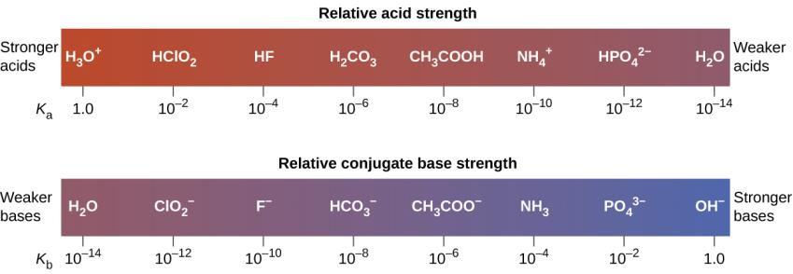
Figure 14.7
Relative strengths of several conjugate acid-base pairs are shown.

Slide 40
Figure 14.8
This figure shows strengths of conjugate acid-base pairs relative to the strength of water as the reference substance.

Slide 41
Acid/Base Strength Notes
The conjugates of weak acids and weak bases are weak bases and weak acids, respectively. But, the weaker the acid, the stronger the conjugate base, and vice versa!
Solutions of these weak acids and weak bases produce an equilibrium mixture of reactants and products.
Just keep in mind that for conjugate acid/base pairs, the following equation must always be satisfied.

Slide 42
Determining K_{a} or K_{b}
There are several ways to determine the K_{a} or K_{b} value of a weak acid or weak base.
One approach is to measure the pH of a solution prepared by dissolving a known amount of the weak acid or base. In these problems…
Given pH
Given some information that can be used to find the initial concentration of the acid or base.
Calculate K_{a} or K_{b}

Slide 43
Ka and pH problems.

Slide 44
Dissociation Constants
For a generalized acid dissociation,
the equilibrium expression would be
This equilibrium constant is called the acid-dissociation constant, K_{a}
HA(aq) + H₂O(l)
A⁻(aq) + H₃O⁺(aq)
[H₃O⁺] [A⁻]
[HA]
[H⁺] [A⁻]
[HA]
K_{a} =
Or,
K_{a} =
Those two expressions mean exactly the same thing!
© 2012 Pearson Education, Inc.

Slide 45
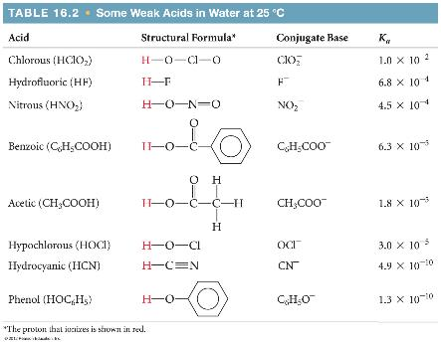
Dissociation Constants
The greater the value of K_{a}, the stronger is the acid.
© 2012 Pearson Education, Inc.

Slide 46
Calculating K_{a} from the pH
The pH of a 0.10 M solution of formic acid, HCOOH, at 25°C is 2.38. Calculate K_{a} for formic acid at this temperature.
We know that
[H₃O⁺] [HCOO⁻]
[HCOOH]
K_{a} =
We know from the ionization equation that the [H+] must = the[ HCOO-] But we can FIND the [H+] from the pH ! The simplest key strokes to do this are, 1. change the sign of the pH. So use -2.38. Then take the ANTILOG (10^{x}) of that number. You should get
4.2 E -3. (Note that for a pH, the sig figs begin after the decimal.)
© 2012 Pearson Education, Inc.

Slide 47
Calculating K_{a} from the pH
The pH of a 0.10 M solution of formic acid, HCOOH, at 25°C is 2.38. Calculate K_{a} for formic acid at this temperature.
To calculate K_{a}, we need the equilibrium concentrations of all three things.
We can find [H₃O⁺], which is the same as [HCOO⁻], from the pH.
(We got 4.2 x 10⁻³)
© 2012 Pearson Education, Inc.

Slide 48
Calculating K_{a} from the pH
pH = −log [H₃O⁺]
2.38 = −log [H₃O⁺]
−2.38 = log [H₃O⁺]
10^{−2.38} = 10^{log [H3O+]} = [H₃O⁺]
4.2 × 10⁻³ = [H₃O⁺] = [HCOO⁻]
© 2012 Pearson Education, Inc.

Slide 49
Calculating K_{a} from pH
Now we can set up a table…
 | [HCOOH], M | [H₃O⁺], M | [HCOO⁻], M
Initially | 0.10 | 0 | 0
Change
At equilibrium
© 2012 Pearson Education, Inc.

Slide 50
Calculating K_{a} from pH
Now we can set up a table…
 | [HCOOH], M | [H₃O⁺], M | [HCOO⁻], M
Initially | 0.10 | 0 | 0
Change | −4.2 × 10⁻³ | +4.2 × 10⁻³ | +4.2 × 10⁻³
At equilibrium
© 2012 Pearson Education, Inc.

Slide 51
Calculating K_{a} from pH
Now we can set up a table…
 | [HCOOH], M | [H₃O⁺], M | [HCOO⁻], M
Initially | 0.10 | 0 | 0
Change | −4.2 × 10⁻³ | +4.2 × 10⁻³ | +4.2 × 10⁻³
At equilibrium | 0.10 − 4.2 × 10⁻³ = 0.0958 = 0.10 | 4.2 × 10⁻³ | 4.2 × 10⁻³
© 2012 Pearson Education, Inc.

Slide 52
Calculating K_{a} from pH
[4.2 × 10⁻³] [4.2 × 10⁻³]
[0.10]
K_{a} =
= 1.8 × 10⁻⁴
© 2012 Pearson Education, Inc.

Slide 53
Calculating K_{a} from pH
[4.2 × 10⁻³] [4.2 × 10⁻³]
[0.10]
K_{a} =
= 1.8 × 10⁻⁴
© 2012 Pearson Education, Inc.

Slide 54
Second sample problem…
A 0.20 molar solution of HF is found to have a pH of 1.95 . What is the Ka of HF?
( 6.3 x 10⁻⁴ )
From the pH, the [H+] is 0.011 M. So the [F-] is also 0.011 M.
The[HF] is 0.20 – 0.011 = 0. 19 M. . [H+][F-]/[HF] = K…

Slide 55
Calculating Percent Ionization
% ionization =( [H+]/[HA]initial) x 100
[H₃O⁺]_{eq}
[HA]_{initial}
Percent ionization = × 100
In previous example,
[H₃O⁺]_{eq} = 4.2 × 10⁻³ M
[HCOOH]_{initial} = 0.10 M
4.2 × 10⁻³
0.10
Percent ionization = × 100
= 4.2%
© 2012 Pearson Education, Inc.

Slide 56
Calculating pH from K_{a}
Calculate the pH of a 0.30 M solution of acetic acid, HC₂H₃O₂, at 25°C.
HC₂H₃O₂(aq) + H₂O(l) H₃O⁺(aq) + C₂H₃O₂⁻(aq)
K_{a} for acetic acid at 25°C is 1.8 × 10⁻⁵.
© 2012 Pearson Education, Inc.

Slide 57
Calculating pH from K_{a}
The equilibrium constant expression is
[H₃O⁺] [C₂H₃O₂⁻]
[HC₂H₃O₂]
K_{a} =
© 2012 Pearson Education, Inc.

Slide 58
Calculating pH from K_{a}
We next set up a table…
 | [C₂H₃O₂], M | [H₃O⁺], M | [C₂H₃O₂⁻], M
Initially | 0.30 | 0 | 0
Change
At equilibrium
We are assuming that x will be very small compared to 0.30 and can, therefore, be ignored.
© 2012 Pearson Education, Inc.

Slide 59
Calculating pH from K_{a}
We next set up a table…
 | [C₂H₃O₂], M | [H₃O⁺], M | [C₂H₃O₂⁻], M
Initially | 0.30 | 0 | 0
Change | −x | +x | +x
At equilibrium
We are assuming that x will be very small compared to 0.30 and can, therefore, be ignored.
© 2012 Pearson Education, Inc.

Slide 60
Calculating pH from K_{a}
We next set up a table…
 | [C₂H₃O₂], M | [H₃O⁺], M | [C₂H₃O₂⁻], M
Initially | 0.30 | 0 | 0
Change | −x | +x | +x
At equilibrium | 0.30 − x ≈ 0.30 | x | x
We are assuming that x will be very small compared to 0.30 and can, therefore, be ignored.
© 2012 Pearson Education, Inc.

Slide 61
Calculating pH from K_{a}
1.8 × 10⁻⁵ =
(x)²
(0.30)
Now,
(1.8 × 10⁻⁵) (0.30) = x²
5.4 × 10⁻⁶ = x²
2.3 × 10⁻³ = x
Note that x is the square root of Ka x Ma. This provides a useful shortcut for acids with small Ka
© 2012 Pearson Education, Inc.

Slide 62
Calculating pH from K_{a}
pH = −log [H₃O⁺]
pH = −log (2.3 × 10⁻³)
pH = 2.64
© 2012 Pearson Education, Inc.

Slide 63
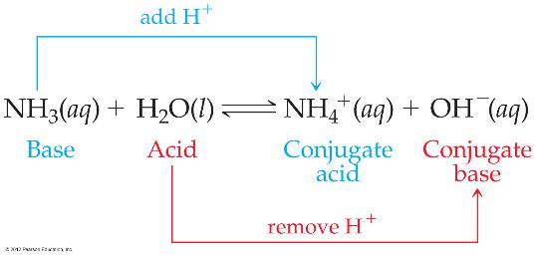
Weak Bases
Bases react with water to produce hydroxide ion.
© 2012 Pearson Education, Inc.

Slide 64
Weak Bases
The equilibrium constant expression for this reaction is
[HB] [OH⁻]
[B⁻]
K_{b} =
where K_{b} is the base-dissociation constant.
© 2012 Pearson Education, Inc.

Slide 65
Finding pH from [OH-].
Before we can solve Kb problems, we need to review how to convert between [OH-] and pH.
What is the pH when the [OH-] = 5.4 x 10⁻⁶ ?
We could find the pOH, = - log[OH-]. = 5.27.
Then pH = 14 – pOH = 14 – 5.27 = 8.73
HOWEVER, if the problem doesn’t ask for pOH, it is surer and faster to do this:
pH = log[OH-] + 14. = log( 5.4 x 10⁻⁶) + 14 =8.73

Slide 66
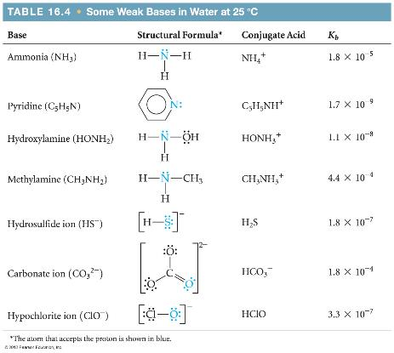
Weak Bases
K_{b} can be used to find [OH⁻] and, through it, pH.
© 2012 Pearson Education, Inc.

Slide 67
pH of Basic Solutions
What is the pH of a 0.15 M solution of NH₃?
NH₃(aq) + H₂O(l)
NH₄⁺(aq) + OH⁻(aq)
[NH₄⁺] [OH⁻]
[NH₃]
K_{b} =
= 1.8 × 10⁻⁵
© 2012 Pearson Education, Inc.

Slide 68
pH of Basic Solutions
Tabulate the data.
 | [NH₃], M | [NH₄⁺], M | [OH⁻], M
Initially | 0.15 | 0 | 0
At equilibrium
© 2012 Pearson Education, Inc.

Slide 69
pH of Basic Solutions
Tabulate the data.
 | [NH₃], M | [NH₄⁺], M | [OH⁻], M
Initially | 0.15 | 0 | 0
At equilibrium | 0.15 − x ≈ 0.15 | x | x
© 2012 Pearson Education, Inc.

Slide 70
pH of Basic Solutions
(x)²
(0.15)
1.8 × 10⁻⁵ =
(1.8 × 10⁻⁵) (0.15) = x²
2.7 × 10⁻⁶ = x²
1.6 × 10⁻³ = x²
Our shortcut here, similar to what we did for acids, becomes [OH-] = KbxMb
[OH-] = (1.8 × 10⁻⁵) (0.15) =0.0016
© 2012 Pearson Education, Inc.

Slide 71
pH of Basic Solutions
Therefore,
[OH⁻] = 1.6 × 10⁻³ M
pOH = −log (1.6 × 10⁻³)
pOH = 2.80
pH = 14.00 − 2.80
pH = 11.20
Or, pH = log{OH-] + 14 = -2.80 + 14 = 11.20
© 2012 Pearson Education, Inc.

Slide 72
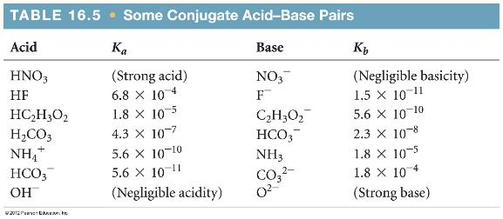
K_{a} and K_{b}
K_{a} and K_{b} are related in this way:
K_{a} × K_{b} = K_{w}
Therefore, if you know one of them, you can calculate the other.
© 2012 Pearson Education, Inc.

Slide 73
Reactions of Anions with Water
Anions are bases.
As such, they can react with water in a hydrolysis reaction to form OH⁻ and the conjugate acid:
The Ka of acetic acid, HC₂H₃O₂ is 1.8 x 10⁻⁵ What is the pH of a solution in which the [ C₂H₃O₂⁻] is 0.40 molar?
⁻C₂H₃O₂⁻(aq) + H₂O(l)
H HC₂H₃O₂(aq) + OH⁻
0.40 M
© 2012 Pearson Education, Inc.

Slide 74
pH of 0.40 M C₂H₃O₂⁻, given that the Ka of HC₂H₃O₂ is 1.8 x 10⁻⁵
C₂H₃O₂⁻ is the conjugate base of HC₂H₃O₂ for conjugates, the Ka of the acid times the Kb of the base = 1.0 x 10⁻¹⁴ So, the Kb here must be 1.0 x 10⁻¹⁴/ 1.8x 10⁻⁵ = 5.6 x 10⁻¹⁰
This is now a Kb problem just like the NH₃ we just did. You could substitute into the equation for the reaction:
C₂H₃O₂⁻(aq) + H₂O(l) ⇄ HC₂H₃O₂ + OH⁻
0.40 0 0
-x +x +x
.40-x x x
So x²/(0.40-x) = 5.6 x 10⁻¹⁰ Assume .40 – x = .40.
Now x² = (0.40)( 5.6 x 10⁻¹⁰), and x = 1.5 x 10⁻⁵ = [OH⁻]

Slide 75
1.5 x 10⁻⁵ = [OH⁻], the pH is 9.18
Using shortcut, [OH-] = 0.40 x 5.6 x 10⁻¹⁰
[ OH-] = 1.5 x 10⁻⁵, same as previous method.
Take the log, add 14, and get 9.18….
In your text, You should be able to do the examples from 14.4 to 14 . 13. Try the “check your learning as well.”

Slide 76
Molecular Structure and Acid Strength
As you can start to see, some acids are stronger than other acids.
Brønsted-Lowry Acids are proton donors.
Consider binary compounds of hydrogen (H–A).
The strength of the acid depends on how easily the bond between the hydrogen and nonmetal (A) is broken.
Acid strength increases as bond strength decreases.

Slide 77
Acid Strength of Binary Hydrogen Compounds
This is a periodic property in terms of nonmetal, A.
Down a group (top to bottom), acid strength increases.
Orbitals of similar size form strong bonds—Good orbital overlap.
Orbitals of different size form weak bonds—Poor orbital overlap.
Hydrogen is the smallest element.
Atoms get larger down a group.
The H–A bond weakens as A changes down a group.
Acid strength increases.

Slide 78
Acid Strength of Binary Hydrogen Compounds
This is a periodic property in terms of nonmetal, A.
Across a period (left to right), acid strength increases.
The more polar the bond, the easier an H⁺ ion is produced.
Electronegativity increases across a period.
The H–A bond becomes more polar as A changes across a period.
The H–A bond weakens across a period.
Acid strength increases.

Slide 79
Example 14.11

Slide 80
Example 14.12

Slide 81
Example 14.13

Slide 82
Example 14.14

Slide 83
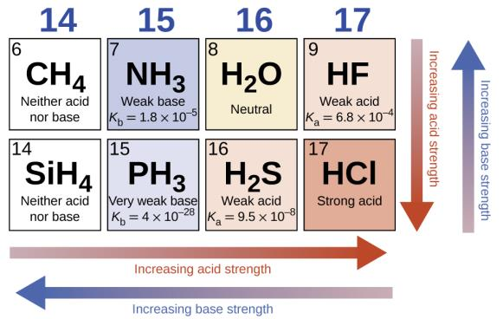
Figure 14.11
The figure shows trends in the strengths of binary acids and bases.

Slide 84
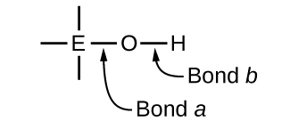
Compounds Containing Oxygen and One or More Hydroxyl Group (OH)
These compounds can be acidic, basic, or amphiprotic depending on the electronegativity of element, E.

Slide 85
Compounds Containing Oxygen and One or More Hydroxyl Group (OH)
If EN of E is low then “Bond a” is polar or ionic.
OH– ions are readily released.
The compound is basic.
Metals have low EN.
Metal hydroxides tend to be basic.

Slide 86
Compounds Containing Oxygen and One or More Hydroxyl Group (OH)
If EN of E is high then “Bond a” is covalent.
Electrons in “Bond b” are pulled toward E.
“Bond b” is polar and weak.
H⁺ ions are readily released.
The compound is acidic.
Nonmetals have high EN.

Slide 87
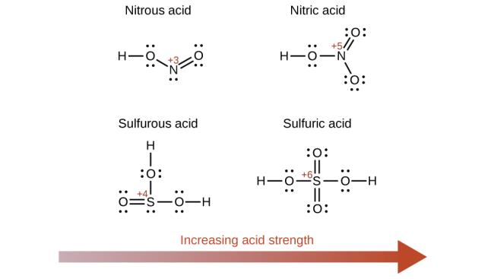
Figure 14.12
As the oxidation number of the central atom E increases, the acidity also increases.

Slide 88
Learning Objectives
14.4 Hydrolysis of Salts
Predict whether a salt solution will be acidic, basic, or neutral
Calculate the concentrations of the various species in a salt solution
Describe the acid ionization of hydrated metal ions

Slide 89
Hydrolysis of Salts
A neutral solution contains equal concentrations of hydronium and hydroxide ions.
The reaction between an acid and a base is called an acid-base neutralization reaction.
What are always the products of such a reaction?

Slide 90
Hydrolysis of Salts
The resulting solution is not necessarily neutral, even when stoichiometrically equivalent quantities of acid and base are used.
The nature of the salt formed determines whether the solution is acidic, basic, or neutral.

Slide 91
Four Types of Acid-Base Neutralizations
Strong Acid-Strong Base
A neutral solution forms.
Strong Acid-Weak Base
A weakly acidic solution forms.
Weak Acid-Strong Base
A weakly basic solution forms.
Weak Acid-Weak Base
The solution formed may be acidic or basic.

Slide 92
Predicting the behavior of salts.
- ions that contain a removable H+ can be acidic OR basic; it depends on Ka values. HCO₃⁻ is slightly basic. HSO₄⁻ is acidic. HPO₄²⁻ is MORE basic. We will NOT ask about those!
Otherwise, the rules can be simplified as follows.
1. Cations. ( + ions). The cations of groups 1 and 2 are neutral. They do not significantly react with water. All OTHER cations, are acidic.
(acidic cations like Al³⁺ and Zn²⁺ attract electrons on the surrounding water molecules, making the WATER molecules acidic.)
Just remember + ions, neutral in groups 1 and 2, otherwise acidic.
2. Anions. Any – ion CAN gain a proton, and so can act as a base. But it needs to be a stronger base than water, to be able to gain a proton from it. F- + H₂O ⇄ HF + OH- Solution is basic.
Cl⁻ + H₂O ……Nothing happens at all! Solution is unaffected.
The key is that HF is a WEAK acid. That makes its conjugate base more basic than water. The – ion from a weak acid is BASIC in water.
HCl is a strong acid, do Cl- ion is a very weak base, weaker than water. It remains neutral in water. Here is a helpful (I think) list.
Neutral ions - All + ions from groups 1 and 2. NO₃⁻ Cl⁻ Br-, I⁻ ClO₄⁻ SO₄²⁻

Slide 93
Strong Acid–Strong Base Reaction
Example: HBr + KOH → KBr + H₂O (KBr is neutral)
Acidic ions - All + ions not in groups 1 and 2
Basic ions. The conjugate bases of WEAK acids. Most commonly,
CO₃²⁻ F⁻ PO₄³⁻ SO₃²⁻
A salt with 2 neutral ions is neutral. One acidic with one neutral =acid
One neutral with one basic = basic. A. BaCl₂ B. FeCl₃ C. K₂CO₃
See problem 69. Problem 70.. KClO₄, NH₄Br.

Slide 94
Strong Acid–Weak Base Reaction
Example: 3 HNO₃ + Al(OH)₃ → Al(NO₃)₃ + 3 H₂O ( acidic)
Consider the salt formed:
Determine the effect that the cation and anion will have on water.

Slide 95
Weak Acid–Strong Base Reaction
Example: 2 HC₂H₃O₂ + Ba(OH)₂ → Ba(C₂H₃O₂)₂ + 2 H₂O ( basic)
Consider the salt formed:
Determine the effect that the cation and anion will have on water.

Slide 96
Finding the pH of a conjugate acid in water
From the Kb, find the Ka of that conjugate.
From there on, it’s just like any other weak acid in water.
Example 14.15 in text: Aniline, C₆H₅NH₂, is a weak base, with a Kb of 4.3 x 10⁻¹⁰ Find the pH of 0.233 molar [ C₆H₅NH₃]Cl
The salt, analinium chloride, [ C₆H₅NH₃]Cl , contains the conjugate ACID of aniline, C₆H₅NH₃⁺. We can find the Ka of the ion, which, as a Bronsted acid, loses a proton to water.
C₆H₅NH₃⁺ + H₂O ⇄ C₆H₅NH₂ + H₃O⁺ Ka = Kw/Kb = 2.3 x 10⁻⁵

Slide 97
Example 14.15
What is the pH of a 0.233 molar solute ion of analinium chloride, [ C₆H₅NH₃]Cl?
The Ka is 2.3 x 10⁻⁵ Now we have the Ma, and the Ka, and the Ka is small. So, [H+] is the square root of KaMa, = 2.3 x 10⁻³ Hit the log key, and you are done! pH = 2.63

Slide 98
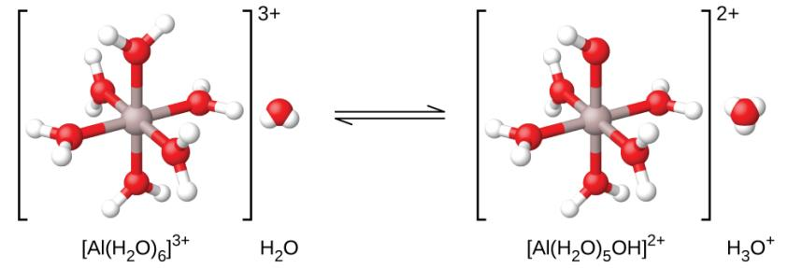
Figure 14.13
When an aluminum ion reacts with water, the hydrated aluminum ion becomes a weak acid.

Slide 99
Example 14.18
The Ka is 1.4 x 10⁻⁵ Find the pH of a 0.10 molar solution of the acid…

Slide 100
Learning Objectives
14.5 Polyprotic Acids
Extend previously introduced equilibrium concepts to acids and bases that may donate or accept more than one proton

Slide 101
Polyprotic Acids
Acids that contain one ionizable hydrogen atom are called monoprotic.
Acids that contain more than one ionizable hydrogen atom are called polyprotic.
Polyprotic acids ionize in steps.
The acid equilibrium constant (K_{a}) becomes smaller with each successive step.

Slide 102
Learning Objectives
14.6 Buffers
Describe the composition and function of acid–base buffers
Calculate the pH of a buffer before and after the addition of added acid or base

Slide 103
Buffers
Buffer: A solution containing appreciable amounts of both a weak acid and its conjugate base (or a weak base and its conjugate acid).
Buffer solutions resist changes in pH upon addition of a small amount of strong acid or base.
Examples: HF and NaF. NH₃ and NH₄Cl HNO₂ and KNO₂ but NOT
HNO₃ and KNO₃

Slide 104
How Buffers Work
Consider the buffer: HA/A–
Buffers are good at getting rid of strong acids and bases.
Added OH– or H₃O⁺ are consumed and therefore do not directly affect the pH.
Any added OH–, is converted into the weak base, A–
HA (aq) + OH– (aq) → A– (aq) + H₂O
Any added H₃O⁺ , is converted to the weak acid, HA
A– (aq) + H₃O⁺ (aq) → HA (aq) + H₂O
Therefore, buffers can be used to maintain a nearly constant pH!

Slide 105
How Buffers Work
CH₃COOH/ NaCH₃CO₂ Buffer
The change in the amounts of CH₃COOH and CH₃CO₂– does result in a small change in pH.

Slide 106
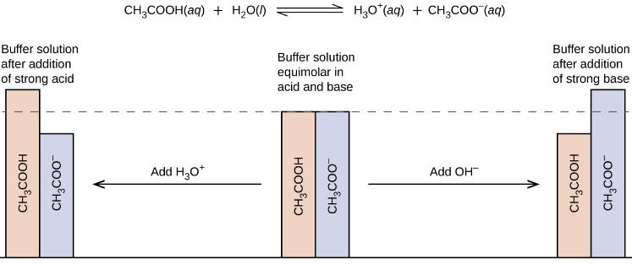
Figure 14.15
Buffering action in a mixture of acetic acid and acetate salt.

Slide 107
Example 14.20
What is the pH of a buffer that is 0.10 M CH₃COOH AND 0.10 CH₃COO⁻ ? Note how the reaction chart is DIFFERENT from that of a simple ionization. The CH₃COO⁻ does NOT start out at zero!
The Ka has to be given; it is 1.8 x 10⁻⁵ Now, substituting into the Ka expression, we get $\frac{\left(x\right).(0.10+x)}{(0.10−x)}$ = Ka. But since the Ka is small, x must be small, and won’t significantly change the initial value of 0.10. So the equation becomes x = Ka!
The pH is just – log Ka, also called pKa, which is 4.74
IF the moles of HA and A- are equal, then [H+] = Ka, and pH = pKa.
We can simplify the equation for a buffer to this, [H+] = Ka (HA/A-)

Slide 108
Similarly, we can find the pH of a buffer from the Kb.
The Kb of NH₃ is 1.8 x 10⁻⁵ What is the pH of a solution that contains 1.0 mol of NH₃ and 2.0 mol of NH₄Cl in 0.50 L of solution?
We COULD find the Ka, and then use the method from the previous problem. If we use the Kb, NH₃+ H₂O ⇄ NH₄⁺ + OH⁻
Now if we make the [OH-] = x, then [NH₃] is 2.0 – x, and
[NH₄⁺] is 4.0+x remember that [ ] means MOLARITY, not moles. We divide the moles by 0.50 L to get the molarity.
So….. [ 4.0 + x][x]/[2.0-x] = Kb. But Kb is small, so we will ignore the changes from initial concentrations. We get 4 x/2 = Kb, and x = half the Kb, or 9.0 x 10⁻⁶ = [OH-] To get the pH you can take the log and add 14. The pH is 8.95.
But remember the shortcut for buffers and Ka? [H+] = Ka (HA)/A-
So, [OH-] = Kb ( A-)/(HA) ( Kb times base over acid) Why no brackets? Because once those + and – x cancel, we CAN use moles here! So…… [OH-] = 1.8 x 10⁻⁵( 1 mol/2 mol) 9.0 x 10⁻⁶ = [OH-]
What if you wanted to use the Ka equation? The Ka is Kw/Kb, which comes out 5.6 x 10⁻¹⁰ So, [H+] = 5.6 x 10⁻¹⁰( 2/1 ) (acid on top now)
[H+] = 1.1 x 10⁻⁹ for a pH of…..8.95 !

Slide 109
The great thing about buffers is that once you have identified a buffer, ( it MUST have both weak acid and weak conjugate base ) you can use the equation [H+] = Ka( HA)/(A-) OR [OH-] = Kb ( A-)/(HA), and get the same pH both ways. AND, if you use moles instead of molarity, it makes no difference at all!! In MOST equilibria, you MUST use molarity.

Slide 110
Finding pH values when acid or base is added to a buffer.
The rule: The addition of H+ (strong acid) to a buffer converts an equimolar amount of A- to HA. The addition of OH- to a buffer converts an equimolar amount of Ha to A-.
Remember that in a buffer, [H+] = Ka ( (HA))/(A-) ( HA and A- represent any acid and its conjugate base.)
Problem 14.20 in text. The Ka of acetic acid, HC₂H₃O_{2,}is 1.8 x 10⁻⁵
(a) Calculate the pH of an acetate buffer that is a mixture with 0.10 M acetic acid and 0.10 M sodium acetate. (b) Calculate the pH after 1.0 mL of 0.10 NaOH is added to 100 mL of this buffer.
a) Since there are equal moles of acid and conjugate base, [H+] = Ka, = 1.8 x 10⁻⁵ for a pH of 4.74. If you didn’t realize that, and used the buffer equation, you would have gotten [H+] = Ka ( 0.10/0.10), same ans.

Slide 111
Now part B. We are adding NaOH, strong base, [OH-] We MUST either use moles of OH- and moles of the acetic acid-acetate, OR, use molarity for both. In buffer problems, BOTH will work, as long as we are consistent. It is usually more convenient to use moles.
We have 0.10 L of 0.10 M , which is 0.010 moles of both HC₂H₃O₂ and C₂H₃O₂⁻
We are adding “1.0 mL of 0.10 NaOH is added to 100 mL of this buffer”
That’s 0.0010 L x 0.10 M = 0.00010 mol of OH-.
That OH- will react with the acid, so it will convert 0.00010 mol of HC₂H₃O₂ into C₂H₃O₂⁻ That means the acid will go DOWN, and the base will go UP, 0.00010 mol.
0.010 + 0.00010 = 0.0101. (base) 0.010 – 0.00010 = 0.0099 mol. (acid)
Now, [H+] = 1.8 x 10⁻⁵ ( 0.0099/0.0101) = 1.76 x 10⁻⁵ (To 2 sig figs, that is no change at all.) That gives a new pH of 4.75. Barely changed at all!!

Slide 112
Let’s try one now where ACID is added to a buffer.
A buffer is made by adding 0.300 mol CH₃COOH and 0.600 mol CH₃COONa to enough water to make 1.000 L of solution. (a) Calculate the pH of this solution. ( The Ka is still 1.8 x 10⁻⁵)
b) Calculate the pH of the buffer after the addition of 25 mL of 4.0 M HNO₃(aq) solution. (c) For comparison, calculate the pH of a solution made by adding 25.0 mL of 4.0 M NaOH(aq) solution to 1.000 L of pure water
( 5.05, 4.84, 13)

Slide 113
Forming a buffer by reacting weak acid with strong base. Or, strong acid with weak base. The WEAK species must be in excess!
Find the pH of the solution formed when 100. mL of 2.00 M HNO₂ ( Ka = 4.6 x 10⁻⁴) is added to 100 mL. of 1.50M
KOH.
We are adding a weak acid to a strong base. We must FIRST write the reaction! HNO₂ + OH⁻ → NO₂⁻ + H₂O
Putting in the moles………0.200 0.150
The OH- is used up…………-0.150 -0.150 + 0.150
After reaction 0.050 0 0.150
We now have a buffer! 0.050 moles HA, 0.150, A-
The [H+] = 4.6 x 10⁻⁴ ( 0.050/0.150 ) = 1.5 x 10⁻⁴ for a pH of 3.81.
Problem 91, which is in the homework is a tough one.
You need to find the moles of NH₄+ (from grams of NH₄Cl) THEN, react that NH₄⁺ with OH- to get NH₃ and water. That will give you your buffer….to begin!

Slide 114
Buffer Capacity
Buffer capacity: Amount of strong acid or base that can be added to a given volume of a buffer solution before the pH changes significantly.
All buffers have a limited capacity of how much H₃O⁺ or OH– they can “soak up.”
Eventually, all the HA reacts with the added OH–
Eventually, all the A– reacts with the added H₃O⁺

Slide 115
Buffer Capacity
Buffer capacity depends on the number of moles of the weak acid and its conjugate base that are in the mixture.
More moles of buffer components leads to a higher buffer capacity.
Once the buffer components near depletion, large changes in pH result.

Slide 116
Determining the [H₃O+] and pH of a Buffer Solution
The pH of a buffer system can be calculated if we know the concentration of the weak acid [HA] and its conjugate base [A–].
HA_{(aq)} + H₂O_{(l)} ⇌ H₃O⁺_{(aq)} + A–_{(aq)}
[H+] = Ka ( HA)/(A-)

Slide 117
Henderson-Hasselbalch Equation
Henderson-Hasselbalch equation can be used to calculate the pH of a buffer.
This is simply the logarithmic form of the buffer equation on the last slide.
Note that the “brackets” indicate molarity. But molarity is moles per liter, and the volume is the same for A- as it is for HA. So, the volume terms “cancel” and it is OK to use moles!

Slide 118
Compare Two Buffer Solutions
Buffer 1:
1 L buffer with 1.0 M CH₃CO₂H and 1.0 M NaCH₃CO₂
Buffer 2:
1 L buffer with 0.1 M CH₃CO₂H and 0.1 M NaCH₃CO₂
They have the same pH, but buffer 1 has 10 times the capacity.
Add 0.1 mol of HCl to both, and buffer 1 will STILL be a buffer, but buffer 2 will just be an acid in water.

Slide 119
Learning Objectives
14.7 Acid-Base Titrations
Interpret titration curves for strong and weak acid-base systems
Compute sample pH at important stages of a titration
Explain the function of acid-base indicators
A titration curve is a graph of volume of base vs. pH, when an acid is titrated with the base.
We can also obtain titration curves for volume of ACID added to base, but we will omit those this term.

Slide 120
Acid-Base Titrations
Recall that we can analyze an acid or base by reacting it with a known concentration of the other.
Three types of titrations
Strong acid-strong base
Weak acid-strong base
3) Strong acid-weak base - not covered this term.
Equivalence Point:
The equivalence point is the point at which the moles of acid = the moles of base. ** Since M x L = moles…
At the equivalence point M xV acid = M x V base.
** Polyprotic acids, like H₃PO₄ will have more than one equivalence point, and the equation above will work only for the FIRST equivalence point. Those titrations will not be covered this term.

Slide 121
Strong Acid-Strong Base Titration
The pH is initially very low (only strong acid present).
Any titration curve can be considered to have four parts.
Initial pH. Before base is added. For a strong acid, the pH is just – log[HA]
Acid range. The moles of acid > moles of base. The pH depends on the molarity of the EXCESS moles of acid.
3. Equivalence point. For strong acid- strong base, the pH=7
4. Base range. Beyond equivalence point. Moles base>moles acid. The pH depends on the molarity of excess base.

Slide 122
Strong Acid-Strong Base Titration
HCl + NaOH → H₂O + NaCl
Suppose we titrate 25 mL of 0.10 molar HCl with 0.10 molar NaOH. We can calculate what the pH would be at ANY point in the titration! (the resulting curve is on the next slide.
Initially, where mL NaOH = 0, we just have 0.10 molar HCl. The pH is 1.00
Now consider what the pH would be after 10.0 mL of the base has been added.We could use an ICE chart
…HCl + NaOH → H₂O + NaCl
Mol 0.0025 0.0010
-.0010 -0.0010
0.0015 0.000 There are 0.0015 excess moles of H+
That MUST be converted to molarity. V = 35 mL. So M = 0.0015mol/0.035 L = 0.043 M The pH is 1.36

Slide 123
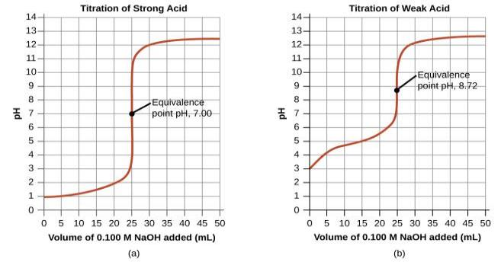
HCl + NaOH → H₂O + NaCl
The graph on the LEFT is for 0.10 M HCl and 0.10 M NaOH
We can see that the pH barely changes until very close to the equivalence point. (25 mL, pH = 7)
You should be able to find the pH at ANY number of mL of base. Try 24 mL, just 1 away from the eq pt. of pH = 7
Moles acid is still 0.0025 moles base is 0.0024. That leaves 0.0001 mol excess acid, in a volume of 0.049 L That is 0.0020molar H+, for a pH of 2.69. One more mL, and the pH JUMPS to 7 !!!

Slide 124
HCl + NaOH → H₂O + NaCl
At 25 mL, pH = 7, (NaCl is a neutral salt). But what happens at 26.0 mL?
Moles of H+ is still 0.0025. But moles of OH- is now 0.0026
That’s 0.0001 mol excess OH-. The volume is now 51.0mL
You should be able to find the molarity of the OH- to be 0.00196 M ( or 0.0020M to 2 sig figs). What is the pH?
Log(0.0020) + 14 = 11.3. (Or, you could find the pOH, which is 2.70, and subtract from 14 to get the same pH)
Notice how in just 2 mL, the pH goes from 2.69, to 7, to 11.3.
Review the table on page 806 !

Slide 125
Weak Acid-Strong Base Titration
CH₃CO₂H + NaOH → H₂O + NaCH₃CO₂
Net ionic is clearer, CH₃COOH + OH⁻ → CH₃COO⁻ + H₂O
But this titration curve is somewhat more complicated.
Of the four sections , only the LAST one (excess base) is the same as with strong acid.
Once again, we will titrate 25.0 mL of the 0.10 molar acid with 0.10 molar base. Note that the molarities in a titration do NOT have to be equal!!
1. The INITIAL pH. Since this is a weak acid, we can’t just take the log of the concentration, as we did for HCl. We need to use the Ka
which is 1.8 x10⁻⁵ Using the Ka equation , where x = [H+], gives us
x²/.10-x = 1.8 x 10⁻⁵ Assuming that the initial conc. Doesn’t change enough to matter, we get x = 0.0013 molar. pH = 2.87. ( Or, for those who like shortcuts, [H+] is the square root of MaKa )

Slide 126
CH₃COOH + OH⁻ → CH₃COO⁻ + H₂O
The ACID range.
What is the pH after 10.0 mL of 0.10 M NaOH is added? We can set up an ice chart, as we did for HCl…..
… HAc+ OH- → H₂O + Ac- ( Ac- = CH₃COO⁻)
Mol 0.0025 0.0010 0
-.0010 -0.0010 +0.0010
0.0015 0.000 0.0010
There are 0.0015 excess moles of HAc . But this is a WEAK acid, and its conjugate base is present. We have formed a buffer! In a titration of a weak acid, a buffer exists throughout the acid range of the titration! There are 0.0010 moles of the conjugate base, Ac-
We could find the molarities by dividing by the volume of 0.035 mL, but SINCE THIS IS A BUFFER, we don’t need to! (you will get the same answer either way)

Slide 127
For buffers, [H+] = Ka Ha/A-
So [H+] = 1.8 x 10⁻⁵ ( 15/10 ) = 2.7 x10⁻⁵ for a pH of 4.57.
We can go back to slide 123 to see how our first 2 points look…
What would the pH be after 12.5 mL ? 12.5 is exactly halfway to the equivalence point. At that point, moles HA MUST = moles of A- !!!
(do the arithmetic!!!)
NOW, using the buffer equation, [H+] = Ka. And pH = pKa.
Just take the log of the Ka and change the sign! pH = 4.74
All points in the acid range are done the same way. See table on p 806

Slide 128
At the equivalence point.
In strong acid-strong base, this was the EASIEST point. Just write
“7” !
But in weak acid- strong base, it is the most difficult point!
At the equivalence point, 25.0 mL in our example, there is no longer a buffer, because the weak acid is gone. All we have is the conjugate base, CH₃COO⁻ and water. But we did learn how to find the pH of a weak base in water!
First, we need to find the Kb of the base. That’s Kw/Ka, and in this case, 1.0 x 10⁻¹⁴/ 1.8 x 10⁻⁵ = Kb = 5.6 x 10^{-10.}
Next, we need the CONCENTRATION of the base, in molarity. Since this is NOT a buffer, we can’t use just moles.
We formed 0.0025 moles of Ac-, in a volume of 50.0 mL, which gives us a molarity of 0.050 M. Since the Kb is VERY small, we can use the simplification, [OH-] = ( Kb Mb)^{.5} = square root of
2.8 x 10⁻¹¹ = 5.3 x 10⁻⁶ pH = 8.72.

Slide 129
Sample titration problem..
(a) Calculate the pH in the solution formed by adding 10.0 mL of 0.050 M NaOH to 40.0 mL of 0.0250 M benzoic acid (C₆H₅COOH, K_{a} = 6.3 × 10⁻⁵. (b) Calculate the pH in the solution formed by adding 10.0 mL of 0.100 M HCl to 20.0 mL of 0.100 M NH₃.
Answers: (a) 4.20, (b) 9.26

Slide 130
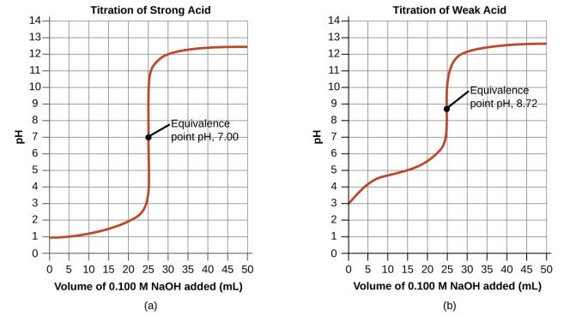
Figure 14.18
(a) The titration curve for the titration of 25.00 mL of 0.100 M CH₃CO₂H (weak acid) with 0.100 M NaOH (strong base) has an equivalence point of 7.00 pH. (b) The titration curve for the titration of 25.00 mL of 0.100 M acetic acid (weak acid) with 0.100 M NaOH (strong base) has an equivalence point of 8.72 pH.

Slide 131
Acid-Base Indicators
Indicators are weak acids.
The weak acid is a different color than its conjugate base.

Slide 132
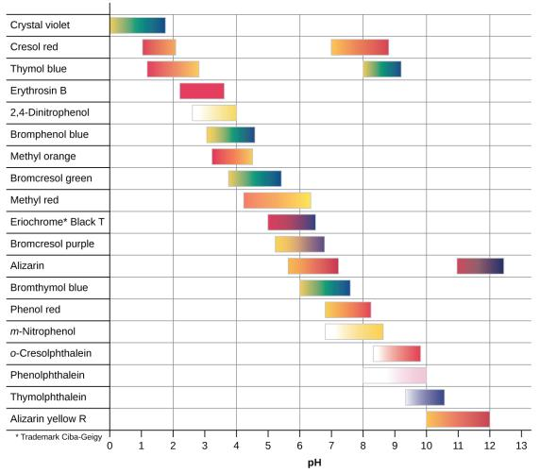
Figure 14.19
This chart illustrates the ranges of color change for several acid-base indicators.

Slide 133
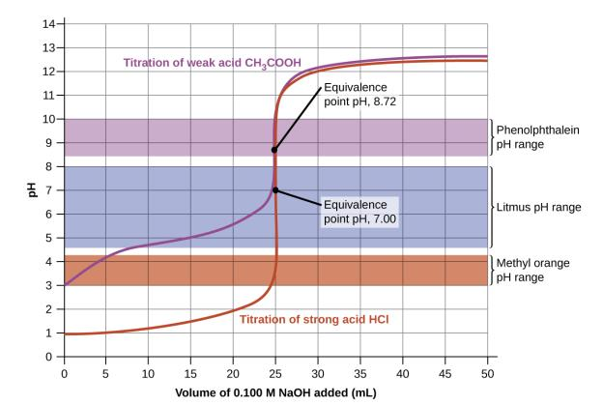
Figure 14.20
Titration curves for strong and weak acids illustrating the proper choice of acid-base indicator. Any of the three indicators will exhibit a reasonably sharp color change at the equivalence point of the strong acid titration, but only phenolphthalein is suitable for use in the weak acid titration.

Slide 134
Indicator Section
Need an indicator that changes color at a pH near the equivalence point.

