Slide 1


CHEMISTRY 2e
Chapter 12 Kinetics
PowerPoint Image Slideshow

Slide 2
Kinetics
© 2012 Pearson Education, Inc.
In kinetics we study the rate at which a chemical process occurs.
Besides information about the speed at which reactions occur, kinetics also sheds light on the reaction mechanism (exactly how the reaction occurs).

Slide 3
Factors That Affect Reaction Rates
Physical state of the reactants.
  In order to react, molecules must come
  in contact with each other.
  The more homogeneous the mixture
  of reactants, the faster the molecules
  can react.
© 2012 Pearson Education, Inc.

Slide 4
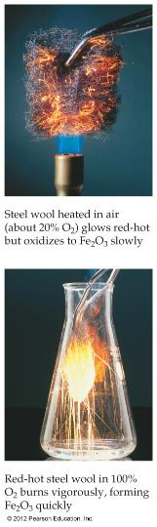
Factors That Affect Reaction Rates
Concentration of reactants.
  As the concentration of reactants increases, so does the likelihood that reactant molecules will collide.
Since during a reaction, concentrations are constantly changing, the rate of a chemical reaction is SELDOM constant!
© 2012 Pearson Education, Inc.

Slide 5
Factors That Affect Reaction Rates
© 2012 Pearson Education, Inc.
Temperature
  At higher temperatures, reactant molecules have more kinetic energy, move faster, and collide more often and with greater energy.

Slide 6
Factors That Affect Reaction Rates
© 2012 Pearson Education, Inc.
Presence of a catalyst.
  Catalysts speed up reactions by changing the mechanism of the reaction.
  Catalysts are not consumed during the course of the reaction.

Slide 7
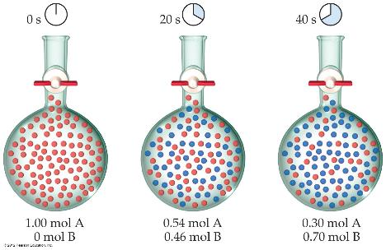
Reaction Rates
Rates of reactions can be determined by monitoring the change in concentration
of either reactants or products as a function
of time.
© 2012 Pearson Education, Inc.

Slide 8
Chapter Outline
12.1 Chemical Reaction Rates
12.2 Factors Affecting Reaction Rates
12.3 Rate Laws
12.4 Integrated Rate Laws
12.5 Collision Theory
12.6 Reaction Mechanisms
12.7 Catalysis

Slide 9
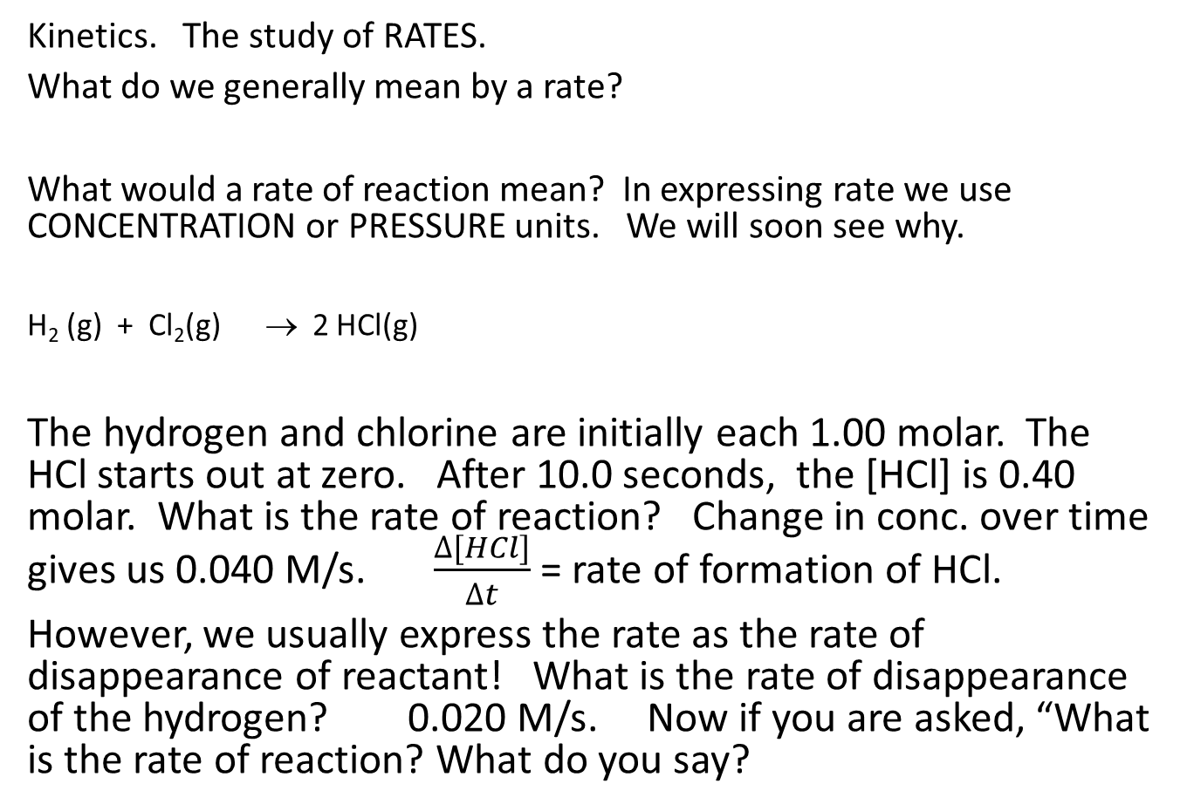
Kinetics. The study of RATES.
What do we generally mean by a rate?
What would a rate of reaction mean? In expressing rate we use CONCENTRATION or PRESSURE units. We will soon see why.
H₂ (g) + Cl₂(g) → 2 HCl(g)
The hydrogen and chlorine are initially each 1.00 molar. The HCl starts out at zero. After 10.0 seconds, the [HCl] is 0.40 molar. What is the rate of reaction? Change in conc. over time gives us 0.040 M/s. $\frac{∆[HCl]}{∆t}$ = rate of formation of HCl.
However, we usually express the rate as the rate of disappearance of reactant! What is the rate of disappearance of the hydrogen? 0.020 M/s. Now if you are asked, “What is the rate of reaction? What do you say?

Slide 10
Learning Objectives
12.1 Chemical Reaction Rates
  Define chemical reaction rate
  Derive rate expressions from the balanced equation for a given chemical reaction
  Calculate reaction rates from experimental data
The RATE is the change in conc. of a component over time. But as we just saw, the rate of change of ONE component ( H2) may not be equal to the rate of change of the other component. (HCl) We would prefer that there just be ONE answer to “What is the rate of the reaction?” We resolve this as follows: “The rate of the overall reaction is the change in conc of the component DIVIDED BY ITS COEFFICIENT!.” That’s so you get the same overall rate, no matter which component you look at. The rate of change of any component with a coefficient on ONE, is the rate of the reaction! The average rate of the reaction over the 10.0 second interval is 0.020M/s
The average rate of disappearance of a component, - say H2 in the example on the last slide, is - Δ[H2]/Δt. The – sign is needed to make the rate come out positive!

Slide 11
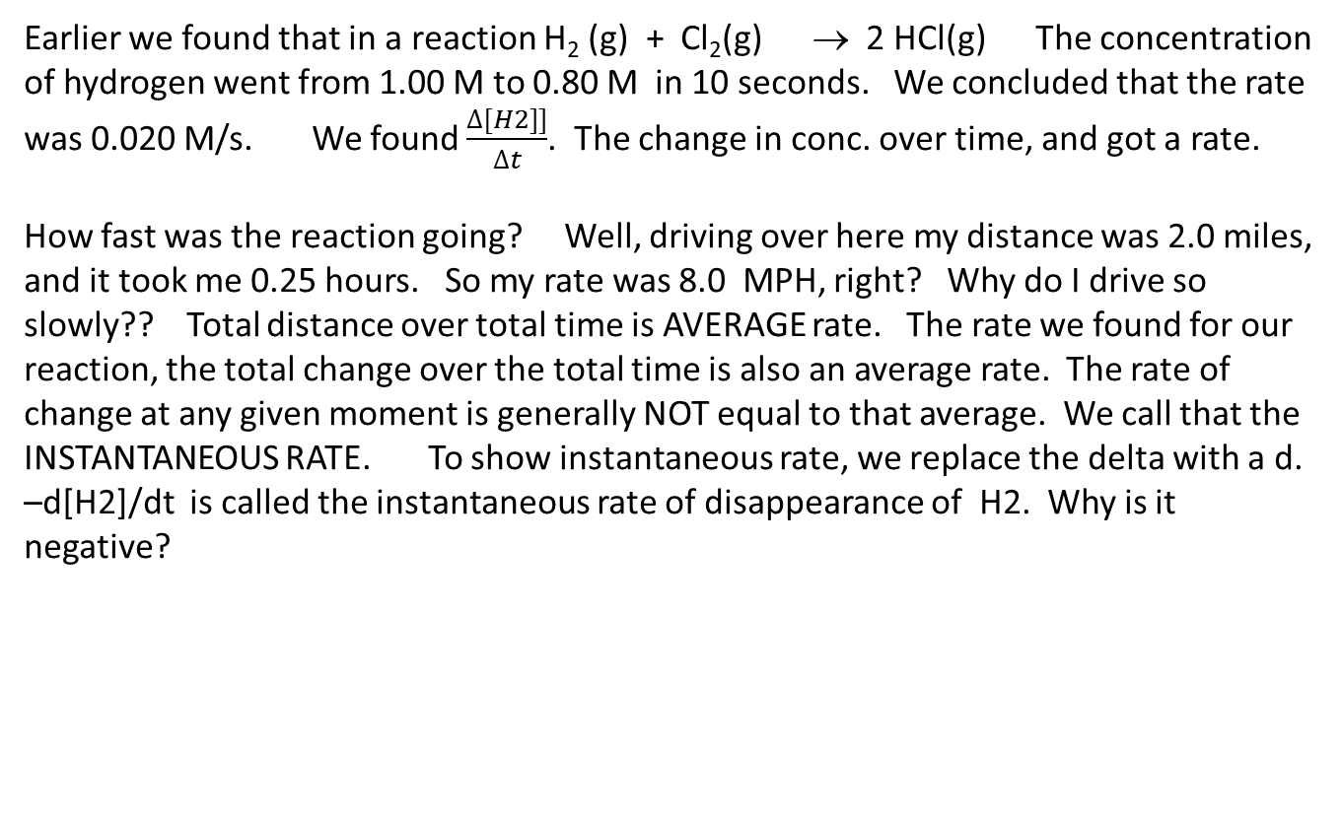
Chemical Reaction Rates
The rate of a reaction is the change in the amount of a reactant or product per unit time.
It is often convenient to express amount in terms of concentration.
We use concentration, because the effect of concentration on the rate is generally predictable. As concentration decreases, rate decreases.
Rate expression: Mathematical representation of rate of reaction.
Earlier we found that in a reaction H₂ (g) + Cl₂(g) → 2 HCl(g) The concentration of hydrogen went from 1.00 M to 0.80 M in 10 seconds. We concluded that the rate was 0.020 M/s. We found $\frac{∆[H2]]}{∆t}$. The change in conc. over time, and got a rate.
How fast was the reaction going? Well, driving over here my distance was 2.0 miles, and it took me 0.25 hours. So my rate was 8.0 MPH, right? Why do I drive so slowly?? Total distance over total time is AVERAGE rate. The rate we found for our reaction, the total change over the total time is also an average rate. The rate of change at any given moment is generally NOT equal to that average. We call that the INSTANTANEOUS RATE. To show instantaneous rate, we replace the delta with a d. –d[H2]/dt is called the instantaneous rate of disappearance of H2. Why is it negative?

Slide 12
Rate Expressions
Reaction rates are always positive quantities.
Concentration is most often expressed in Molarity.
Rate expressions can be written in terms of reactant or product concentration.
For the reaction of hydrogen with chlorine, the average rate of disappearance of hydrogen is - Δ [H2]/ Δt The negative sign is needed to make the rate come out positive. “Δ”, the symbol for “change in” always means final minus initial. Since the reactant is disappearing, the final must be LESS than the initial, so Δ[H2] is negative. We want the rate to be POSITIVE so we put a – sign in front of the change in any reactant.
If we want to compare the instantaneous rate of disappearance of the hydrogen, to the rate of APPEARANCE of the HCl, we would write “- d [H2]/ Δt = ½ d[HCl]/Δt Because of the different coefficients, hydrogen is disappearing at HALF the rate that HCl is appearing.

Slide 13
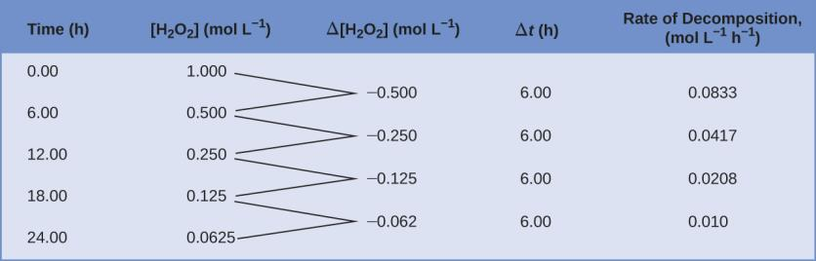
The table below shows the concentration over time of a sample of H2O2 , as it decomposes. The third column shows the CHANGE in concentration over a 6 hour interval.
The rate of decomposition of H₂O₂ in an aqueous solution decreases as the concentration of H₂O₂ decreases. The smaller the concentration, the smaller the probability of molecular collisions, and therefore, the lower the rate. In general, as reactions occur, they get SLOWER.

Slide 14
Average vs. Instantaneous Reaction Rates
Average reaction rate: The rate at which a reaction proceeds over a time period.
  Calculated using concentrations at the beginning and end of a time period.
Instantaneous reaction rate: The rate at which a reaction is proceeding at a specific time and/or conc.
  Calculated using a graph (Conc. vs. time) and a slope of a straight line tangent to the curve at that specific time.
  Or by determining the avg. rate of reaction over a very short time period.
Initial reaction rate: The instantaneous reaction rate at “time zero”.

Slide 15
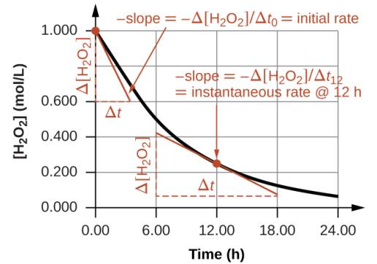
Figure 12.3
Determining Different Rates of Reaction
2H₂O₂(aq) → 2H₂O(l) + O₂(g)
This graph shows a plot of concentration versus time for a 1.000 M solution of H₂O₂. The rate at any instant is equal to the opposite of the slope of a line tangential to this curve at that time. Tangents are shown at t = 0 h (“initial rate”) and at t = 10 h (“instantaneous rate” at that particular time).

Slide 16
Relative Rates of Reaction
The rate of a reaction may be expressed in terms of the change in concentration of any reactant or product.
Stoichiometric factors derived from a balanced equation may be used to relate reaction rates.

Slide 17
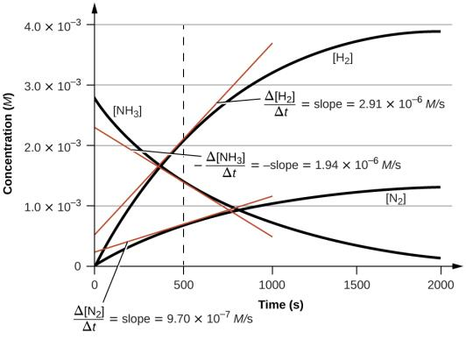
Figure 12.5
This graph shows the changes in concentrations of the reactants and products during the reaction 2NH₃ ⟶ N₂ + 3H₂. The rates of change of the three concentrations are related by their stoichiometric factors, as shown by the different slopes of the tangents at t = 500 s. How would you EXPECT the 3 instantaneous rates to compare at the same moment? (500 s)

Slide 18
Learning Objectives
12.2 Factors Affecting Reaction Rates
  Describe the effects of chemical nature, physical state, temperature, concentration, and catalysis on reaction rates

Slide 19
Factors Affecting Reaction Rates
Chemical nature of the reactants.
  Example: As you move down a group the alkali metals react at a faster rate with water.
https://www.youtube.com/watch?v=jI__JY7pqOM

Slide 20
Factors Affecting Reaction Rates
The state of subdivision of the reactants.
  The rate of most reactions increase with increasing surface area contact between reactants.

Slide 21
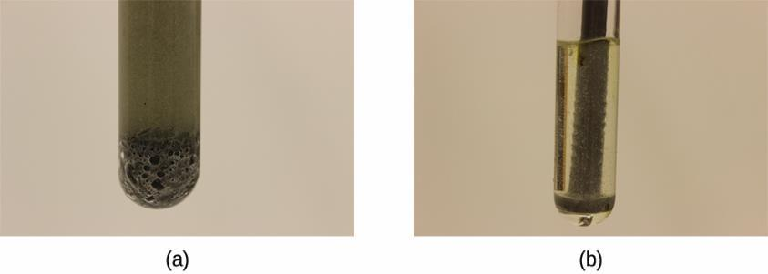
Figure 12.6
(a) Iron powder reacts rapidly with dilute hydrochloric acid and produces bubbles of hydrogen gas: 2Fe(s) + 6HCl(aq) ⟶ 2FeCl3(aq) + 3H₂(g). (b) An iron nail reacts more slowly because the surface area exposed to the acid is much less.

Slide 22
Factors Affecting Reaction Rates
Temperature of the reactants.
  Reaction rate ordinarily increases with temperature.
Concentration of the reactants.
  Reaction rate ordinarily increases with the concentration of reactants.
The presence of a catalyst

Slide 23
Rate and Collision
Chemical reactions occur as the result of collisions between reactant molecules.
The higher the concentration of reactant molecules, the more likely molecules will collide and react, and therefore the faster the reaction rate.
https://www.youtube.com/watch?v=m4_twEXWjgg
As reactants get consumed, collisions happen less frequently and the reaction rate decreases.

Slide 24
Learning Objectives
12.3 Rate Laws
  Explain the form and function of a rate law
  Use rate laws to calculate reaction rates
  Use rate and concentration data to identify reaction orders and derive rate laws

Slide 25
Rate Laws
Rate is directly related to reactant concentration.

Slide 26
Rate Laws
N₂O₅ (g) → 2NO₂ (g) + ½O₂ (g)
The rate law for this reaction is: rate = k[N₂O₅]
  Only reactants appear in a rate law.
  k is the rate constant for the reaction.
The rate law is used to calculate the instantaneous rate or initial rate of reaction with a specific reactant concentration.
Let’s say that when the [N₂O₅] is 2.00 M, the instantaneous rate is 0.500 M/s. What is the value of the rate constant, k? 0.250. And what is the unit? Factor labeling, we divided .500 M/s by 2.00 M. The remaining unit is 1/s or s⁻¹
We would correctly write that the rate constant is 0.250 /s ( or s⁻¹ )
Solve this problem: What is the rate of formation of O2 when the [N2O5] is 1.00 molar?
a) Since we know that k = 0.250/s, Rate = k [N₂O₅] = 0.250/s ( 1.00 M) = 0.250 M/s But that is not the answer to the question!
b) The rate of formation of the Oxygen, from the balanced equation, is only HALF the rate of disappearance of the N₂O_{5.} So the oxygen is formed at 0.125 M/s
Unfortunately, it is not generally that simple!!

Slide 27
Rate Constant, k
The rate constant, k is specific for a particular reaction at a particular temperature.
k is independent of reactant concentration.
k must be determined experimentally.

Slide 28
Rate Laws
Experiments must be done to determine the rate law for a reaction.
  Can’t just use a balanced chemical equation.
  A single event in the course of a reaction is called an elementary step.
  If you shot the cue ball at the 5 and the 6 ball, and it hit both simultaneously, that would be an elementary step. But if it first hit the 5, and THEN hit the 6, it would be a two step process.
  Let’s say the reaction H2 + Cl 2 → 2 HCl occurred in one, elementary step. The hydrogen molecules collide with the chlorine molecules.
  What effect would doubling the [H2] have on the rate? With twice the conc. of hydrogen, there would be twice as many collisions per unit time. The rate would double. What if we doubled the [Cl2] ? That would ALSO double the rate. What if we doubled both?
  We can write the rate law, Rate = k[H2][Cl2] The rate is directly proportional to the PRODUCT of the concentrations of H2 and Cl2. To get the rate law from an elementary step, we simply multiply k by the concentrations of all of the molecules……..IF they all have coefficients of 1.
  But what if we have a reaction like 2 H → H2. We could write this as H + H → H2.
  Then the rate law would be Rate = k [H]² Since the reaction involves a collision between 2 H atoms, The [H] must be SQUARED in the rate law. The rate law for an ELEMENTARY step always = k times the product of EACH component, raised to the power of its coefficient.
  The exponent is called the RATE ORDER of that component. In the reaction between H2 and Cl2 the reaction was first order in H2 and first order in Cl2. In our second reaction, the reaction was SECOND order in hydrogen
  The SUM of the exponents in the rate law is called the rate order of the reaction. BOTH of our reactions are second order!

Slide 29
Order with Respect to a Reactant
The order with respect to a reactant indicates the dependence of the reaction rate on the concentration of that particular reactant.
The overall order gives an understanding of how all the reactants contribute to the rate of a reaction.
  Also, dictates the units of the rate constant for that reaction.

Slide 30
Determination of a Reaction’s Rate Law
One way to determine the rate law of a reaction is to measure the initial rate.
  The rate at time zero.
If the initial rate is measured with a number of different initial reactant concentrations then the rate law can be determined.

Slide 31
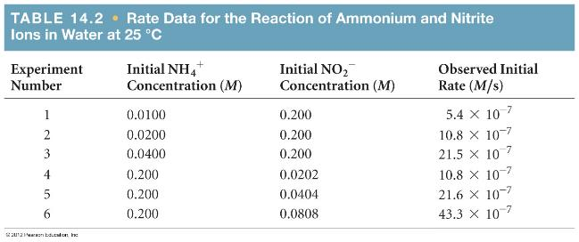
Concentration and Rate
NH₄⁺(aq) + NO₂⁻(aq)
N₂(g) + 2 H₂O(l)
If we compare Experiments 1 and 2, we see that when [NH₄⁺] doubles, the initial rate doubles. Since the rate is directly proportional to the NH4 concentration, it is FIRST order for NH4+.
© 2012 Pearson Education, Inc.

Slide 32
Now look at how changing the NO2- concentration affects the rate. The problem is made easier, because the NH4+ is held constant in experiments 4 through 6. We can easily see that NO2- is first order as well; when its conc. Doubles, while the NH4+ is constant, the rate doubles.
Then the rate law is Rate = k[NH4+][NO2-] The reaction is SECOND order, but each component is first order.

Slide 33
We can NOW, find the rate constant. Use any experiment you wish, you should get the same rate constant. If you don’t, then your rate law is incorrect. I’ll use exp 1. 5.4 x 10⁻⁷ = k[0.0100][0.200]
K = 2.7 x 10 ⁻⁴ But what is the unit? We are dividing M/s by M^2.
That gives us M^-1/s. The overall reaction is second order. In general, the unit of k will be M^(1-r)/s, or Molarity to the 1-r power, per second. ( or any other time unit) So for a second order reaction, 1-r is 1-2, which is -1, so the unit is M ⁻¹ /s

Slide 34
See pages 670 to 672 in the text for applications of the equation on the previous slide.

Slide 35
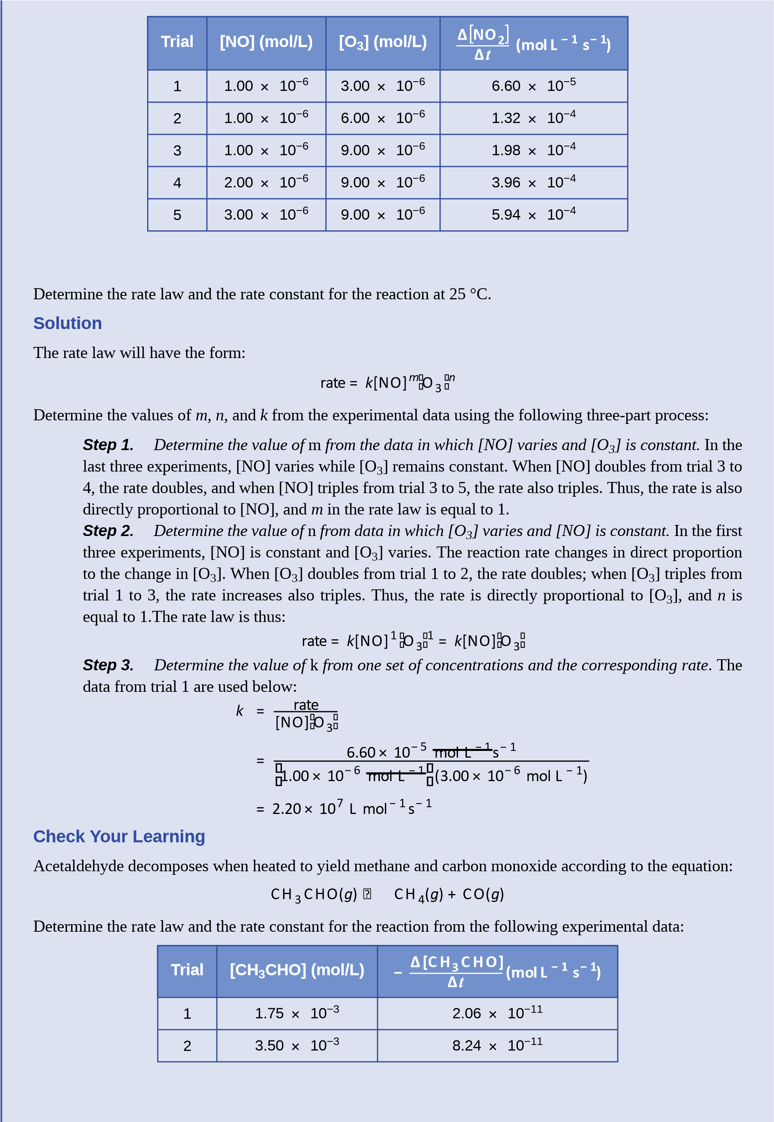

Slide 36
Δ[
CH
C HO]
−1
−1
−
3
(
mol
Trial
[
CH
CHO] (mol/L)
L
s
)
3
Δ
t
3
7.00
×
10
⁻³
3.30
×
10
⁻¹⁰
rate
=
k
⎡
CH
⎤
2
×
⁻⁶
Answer:
CHO
with
⎣
3
⎦
k
= 6.73
10
L/mol/s

Slide 37
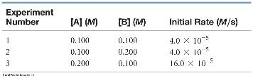
Sample Exercise 14.6 Determining a Rate Law from Initial Rate Data
The initial rate of a reaction A + B → C was measured for several different starting concentrations of A and B, and the results are as follows:
Using these data, determine (a) the rate law for the reaction, (b) the rate constant, (c) the rate of the reaction
when [A] = 0.050 M and [B] = 0.100 M.
Solution
Analyze We are given a table of data that relates concentrations of reactants with initial rates of reaction and asked to determine (a) the rate law, (b) the rate constant, and (c) the rate of reaction for a set of concentrations not listed in the table.
Plan
(a) We assume that the rate law has the following form: Rate = k[A]^{m}[B]^{n}. So we must use the given data to deduce the reaction orders m and n by determining how changes in the concentration change the rate. (b) Once we know m and n, we can use the rate law and one of the sets of data to determine the rate constant k. (c) Now that we know both the rate constant and the reaction orders, we can use the rate law with the given concentrations to calculate rate.

Slide 38
From the first 2 experiments, with A constant, B doubles. The rate stays the same. That means that B is zero order.
Runs 1 and 3, B is constant, but A doubles. The rate became FOUR times greater. Four times is “doubled” squared, so A is second order.
The rate law is Rate = k [A]² We could also write k[A]²[B]º , but since any number to the zero power is one, we can just leave out the “B”. It does not affect the rate.
Now to find the rate constant, k. Choose ANY of the 3 experiments.
Rate = k[A]² In run 1, 4.0 x 10⁻⁵ M/s = k[0.10]² k = 4.0 x 10⁻³
Remember to write a unit! 4.0 x 10⁻³ M⁻¹/s
Part c can be solved two ways. Let’s use the rate constant we just found. Rate = 4.0 x 10⁻³ M⁻¹/s ( 0.050 M)² = 1.0 x 10⁻⁵
We could also notice that B doesn’t matter, but the value of [A] at 0.050 is half of what it was in run 1. Since A is second order, if it is halved, the rate should be ¼ as much, which gives the same answer!

Slide 39
Experimental data were collected for the following reaction:
2 A + 3 B → 2 D + E
Experiment | Initial [A] | Initial [B] | Initial rate M/s
1 | 0.100 M | 0.200 M | 1.000 x 10⁻³
2 | 0.350 M | 0.200 M | 1.225 x 10⁻²
3 | 0.700 M | 0.900 M | 4.90 x 10⁻²
Write the rate law for the reaction.
Find the value of the rate constant, k. Include correct units.
When [B] is 0.100 M, what concentration of A would produce an initial rate of 7.90 x 10⁻² ?

Slide 40
Learning Objectives
12.4 Integrated Rate Laws
  Explain the form and function of an integrated rate law
  Perform integrated rate law calculations for zero-, first-, and second-order reactions
  Define half-life and carry out related calculations
  Identify the order of a reaction from concentration/time data

Slide 41
Integrated Rate Laws
So far we have only talked about the concentration-rate relationship.
A → products Rate = k[A]^{m}
The rate law can be integrated with respect to time to produce a concentration-time relationship known as an integrated rate law.
This relationship depends on the order of the reaction: Zero order, 1st order, 2nd order, etc.
In a zero order reaction, [A] ° must be 1. ANY number to the zero power is 1. The equation becomes Rate = k. Zero order implies constant rate. (at constant T)
A new term, the half-life, will also be introduced.

Slide 42
First-Order Reactions
For 1st order reactions of the type A → products
rate = k[A]
Integration with respect to time gives us:
k is the rate constant
t is time
[A]₀ is the initial reactant conc.
[A]_{t} is the reactant conc. present at time t

Slide 43
Linear Form of the First-Order Integrated Rate Law
We can put the first-order integrated rate law into the form
y = mx + b
  ln[A]_{t} plotted on the y-axis
  time (t) plotted on the x-axis
  The slope of the line is –k
  The y-intercept is ln[A]₀

Slide 44
Graph of molarity vs. time for 0, 1st, and second order rxns.

Slide 45
Look at line B (red). What is indicated about the reaction rate by the fact that the graph is a straight line? 0 order reactions are relatively rare.
Lines A and C ( blue and green) are BOTH curved. One is first order, one is second. Can we determine which is which?
Going back to slide 40, we see that for a FIRST order reaction, a graph of Ln[X] vs time produces a straight line. The slope is –k for that reaction.

Slide 46
Find the slope of line C. We know because the LnC vs time graph is linear, that reaction C is first order. Rate = k[C]. And k = - slope. (the slope here is negative, but k is always a positive number.

Slide 47
You can pick any two points on the line ( C ) to get the slope. When “X” is 24 sec, “Y” is -1. When X is 34 seconds, Y is -2. That gives us a slope of -0.10, so k = .10
We can now use the equation Ln[A]t = Ln [Ao] - kt.
Go back to slide 41. The INITIAL [C} was 4 molar. How long would it take for it to become 1 molar? Ln 4 - Ln 1 = .10 t. It should be 13.8 seconds.
Given the initial [C] of 4 molar, what should its molarity be after 20 seconds?
Ln 4 - Ln x = 20 ( .10 ) Ln x = Ln 4 - 2. Ln x = -0.613. To solve for “x”, we use the “Inverse log” key or e to the x key on the calculator. You should get that x = 0.54.
You can see that those two values, 13.8 s and 0.54 molar correspond to the molarity graph.

Slide 48
Integrated Rate Laws
Note that when using all of the integrated rate laws
The amount of reactant (A) does not always need to be expressed in Molarity (M) as the equations imply.
The amount can also be expressed in
  Mass (g, mg, etc.)
  Number of molecules or atoms
  Other conc. units such as g/L
  Partial pressure if A is a gas (assuming volume and temperature remain constant).

Slide 49
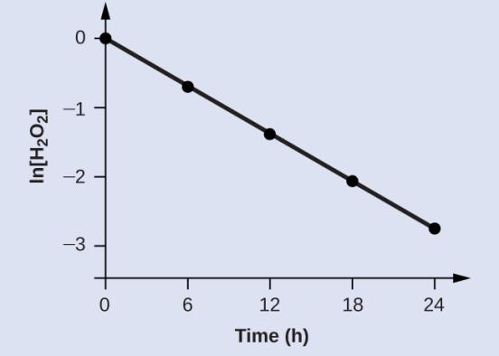
Figure 12.9
The linear relationship between the ln[H₂O₂] and time shows that the decomposition of hydrogen peroxide is a first-order reaction.

Slide 50
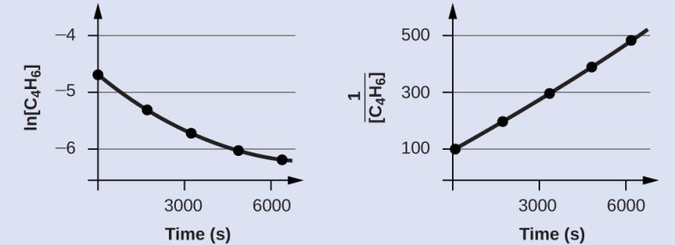
Figure 12.10
These two graphs show first- and second-order plots for the dimerization of C₄H₆. The linear trend in the second-order plot (right) indicates that the reaction follows second-order kinetics.
As you can see, a second order system produces a straight line when 1/[A] is plotted against time. The slope = k. You will NOT be tested on second order graphs. However, you should be able to tell from these graphs that it is NOT first order!

Slide 51
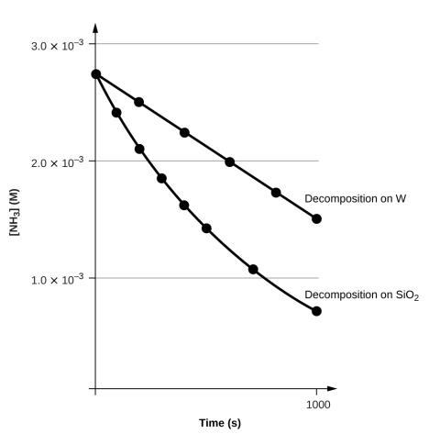
Figure 12.11
The decomposition of NH₃ on a tungsten (W) surface is a zero-order reaction, whereas on a quartz (SiO₂) surface, the reaction is first order.

Slide 52
The Half Life: First-Order Reaction
The half-life (t_{1/2}) of a reaction is the time it takes for one half of a given amount of reactant to be consumed.
If the initial concentration is Ao, then after the half life passes, the concentration by definition must be Ao/2.
Using the first order equation, we get Ln (Ao/2) – Ln(Ao) =- kt _{1/2.}
Then Ln(Ao) – Ln(2) – Ln (Ao) = - kt _{1/2}, and Ln(2) = kt _{1/2}
(where t _{1/2} is the half life). The ln of 2 is 0.693, and that gives us the half life = .693/k. That means, since k is a constant, that the half life MUST be constant as well! One way to identify a first order system is that it has a constant half life. If you look at line C, it takes about 7 seconds to go from 4 molar to 2 molar. Since we know k = 0.10, the half life should be .693/.10 = 6.93 seconds.

Slide 53
The Half Life: First-Order Reaction
Notice that for a first-order reaction, the half-life is independent of the initial concentration of reactant.

Slide 54
The isomerization of cyclobutene to butadiene is first-order and the rate constant has been measured as 2.0 × 10^{–4} s^{–1} at 150 °C in a 0.53-L flask. Determine the partial pressure of cyclobutene and its concentration after 30.0 minutes if an isomerization reaction is carried out at 150 °C with an initial pressure of 55 torr.
Note that finding the concentration requires using the gas laws, so we won’t do that today. We don’t need the temperature or volume of the flask to find just the partial pressure. Remember that we can use pressure in kinetics just as we would use molarity.
The first law equation is Ln[A₀] - Ln[A] = kt.
So, Ln[55] – Ln[x] = (2.0 × 10^{–4} s^{–1} ) ( 30.0 )
Now solve for “x”……. And get the wrong answer! Why? I deliberately left out the unit for time. It has to agree with the unit of k !!!! Let’s convert it to seconds…… 1800 seconds. So…
Ln[55] – Ln[x] = (2.0 × 10^{–4} s^{–1} )(1800 s)
Do you know how to solve this for “x”? You have to be able to do this.
A little algebra gives us Ln(55) – (1800)(2.0 x 10⁻⁴) = Ln x
You should be able to get 3.65 = Ln x. Do you know how to solve for x?
To “unlog” the x requires the “e^{x} “ key. If you have 3.65 in your display, You need to hit the “e^{x} “ key to get the answer, 38 torr.

Slide 55
Assume that the decomposition of COCl₂ is first order. It is found that at a certain temperature, it takes 1400. seconds for a 2.00 molar sample of COCl₂ to decompose to 1.50 molar.
How long would it take to decompose to 1.00 molar?
YOU MUST FIND THE RATE CONSTANT FIRST!!!
What is the half life of the COCl2 here?
.

Slide 56
. It is found that at a certain temperature, it takes 1400. seconds for a 2.00 molar sample of COCl₂ to decompose to 1.50 molar.
How long would it take to decompose to 1.00 molar?
Ln 2.00 - Ln 1.50 = 1400.s ( k). k = 2.05 x 10⁻⁴/s
Ln 2.00 - Ln (1.00) = 2.05 x 10⁻⁴/s ( x) x = 3.37 x 10³ s.
What is the half life? 0.693/ 2.05 x 10⁻⁴/s= 3.38 E3. Why are the two answers the same??

Slide 57













Learning Objectives
12.5 Collision Theory
  Use the postulates of collision theory to explain the effects of physical state, temperature, and concentration on reaction rates
  Define the concepts of activation energy and transition state
  Use the Arrhenius equation in calculations relating rate constants to temperature

Slide 58
Collision Theory
Collision theory: Reactants (atoms, molecules, or ions) must collide in order to react with each other.
The rocks have to hit the window panes, for the glass to break…
Postulates of Collision theory:
Rate of Reaction is proportional to the rate of reactant collisions.
The rate of window breaking is proportional to the number of rocks colliding with the windows per unit time.

Slide 59
Collisions: Effective and Ineffective
Why does every collision not lead to a reaction?
Molecules must be oriented properly when they collide.
The rocks have to hit the glass, not the frame.
The pointy end of the rock has to hit the glass, not the flat side.

Slide 60
Collisions: Effective and Ineffective
Why does every collision not lead to a reaction?
Molecules must have adequate kinetic energy to react.
  The kinetic energy supplied must be high enough to break the chemical bonds.
  Molecules with kinetic energies too small just bounce off each other and don’t react.
  This required energy is called the activation energy
Activation energy (E_{a}): minimum energy necessary to form a product during a collision between reactants.
If you don’t throw the rocks hard enough, you don’t break ANY windows. The greater the energy needed to break a window, the SLOWER the rate . So the greater the Ea, the SLOWER the reaction!

Slide 61
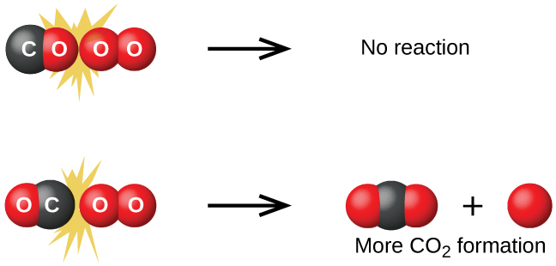
Figure 12.13
Illustrated are two collisions that might take place between carbon monoxide and oxygen molecules. The orientation of the colliding molecules partially determines whether a reaction between the two molecules will occur.

Slide 62
Transition-State Model
Reaction energy diagram
  Potential energy is plotted on the y-axis
  Reaction path (or extent of reaction) is plotted on the x-axis.
The reactants form an intermediate called an activated complex.
  The state of the system at the activated complex is called a transition state.

Slide 63
Reaction Rate and Temperature
Thus far we have discussed:
  The concentration-rate relationship
  The concentration-time relationship
Now we will look at the temperature–rate relationship.
Reaction rate ordinarily increases with temperature.
  To cook food more quickly, raise the oven temperature.
  To slow the reactions that lead to food spoilage, put food in the refrigerator.
  To really slow the reactions down, put food in the freezer.

Slide 64
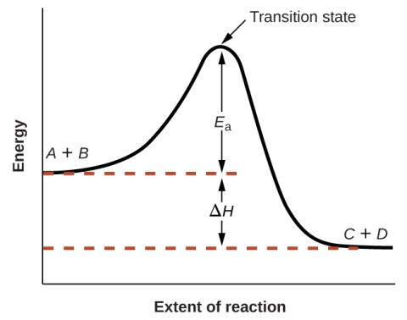
Figure 12.14
This graph shows the potential energy relationships for the reaction A + B ⟶ C + D. The dashed portion of the curve represents the energy of the system with a molecule of A and a molecule of B present, and the solid portion the energy of the system with a molecule of C and a molecule of D present. The activation energy for the forward reaction is represented by E_{a}. The activation energy for the reverse reaction is greater than that for the forward reaction by an amount equal to ΔH. The curve’s peak is represented the transition state.

Slide 65
Kinetic Theory
Temperature is a measure of the average kinetic energy of molecules.
Higher temperatures mean higher kinetic energies.
The higher the temperature, the larger the fraction of molecules with kinetic energies equal to or greater than the activation energy (E_{a}).
With a larger fraction of molecules possessing E_{a}, a larger fraction of collisions lead to product formation, resulting in a higher rate of reaction.

Slide 66
Kinetic Theory
Consider the following equation:
A is a constant called the frequency factor and is related to the frequency of collision and orientation.
The rate constant (k) is dependent on the activation energy of the reaction and the temperature.
But notice that the relationship between k and Ea is EXPONENTIAL. A small change in Ea can result in a LARGE change in rate. Also note the negative sign! The larger the Ea, the SMALLER the rate constant.

Slide 67
Kinetic Theory
Consider two different reactions that occur at the same temperature. Each reaction has a different E_{a}.

Slide 68
Kinetic Theory
Consider the same reaction at two different temperatures. E_{a} is independent of temperature.

Slide 69
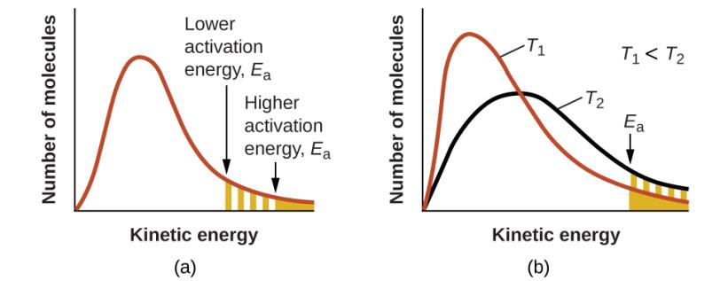
Figure 12.15
The area under the curve (right) is directly proportional to the number of molecules possessing those energies.
Molecular energy distributions showing numbers of molecules with energies exceeding (a) two different activation energies at a given temperature, and (b) a given activation energy at two different temperatures.

Slide 70
Arrhenius Equation
Taking the natural logarithm of both sides of the equation gives the Arrhenius equation.

Slide 71
Two-Point Form of the Arrhenius Equation
This form of the Arrhenius equation can be used with two k values and two corresponding temperatures to calculate E_{a}.
You do not need to know the value of the constant, A, to use this equation.
Make sure that the energy units on E_{a} and R are identical.

Slide 72
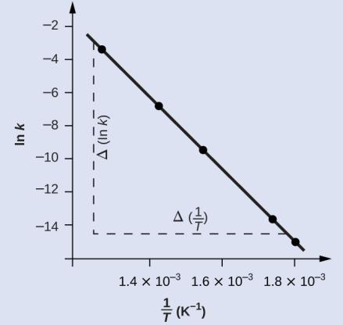
Figure 12.16
This graph shows the linear relationship between ln k and 1/T for the reaction 2HI ⟶ H₂ + I₂ according to the Arrhenius equation.

Slide 73
Learning Objectives
12.6 Reaction Mechanisms
  Distinguish net reactions from elementary reactions (steps)
  Identify the molecularity of elementary reactions
  Write a balanced chemical equation for a process given its reaction mechanism
  Derive the rate law consistent with a given reaction mechanism

Slide 75
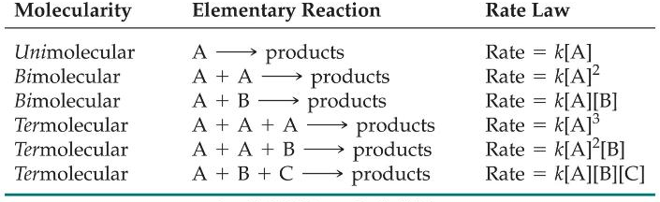
Reaction Mechanisms
The molecularity of a process tells how many molecules are involved in the process.

Slide 76
Multistep Mechanisms
In a multistep process, one of the steps will be slower than all others.
The overall reaction cannot occur faster than this slowest, rate-determining step.
When the slow step is the FIRST step, the rate law of the reaction is the same as the rate law of that step.

Slide 77
Slow Initial Step
NO₂ (g) + CO (g) ⎯⎯→ NO (g) + CO₂ (g)
The rate law for this reaction is found experimentally to be
Rate = k [NO₂]²
CO is necessary for this reaction to occur, but the rate of the reaction does not depend on its concentration.
This suggests the reaction occurs in two steps.

Slide 78
Slow Initial Step
A proposed mechanism for this reaction is
Step 1: NO₂ + NO₂ ⎯⎯→ NO₃ + NO (slow)
Step 2: NO₃ + CO ⎯⎯→ NO₂ + CO₂ (fast)
The NO₃ intermediate is consumed in the second step.
As CO is not involved in the slow, rate-determining step, it does not appear in the rate law.
When the FIRST step is the slow step, the rate law is the rate law of that elementary step!

Slide 79
Fast Initial Step
2 NO (g) + Br₂ (g) ⎯⎯→ 2 NOBr (g)
The rate law for this reaction is found to be
Rate = k [NO]² [Br₂]
Because termolecular processes are rare, this rate law suggests a two-step mechanism.

Slide 80






Fast Initial Step
A proposed mechanism is
Step 1: NO + Br₂
NOBr₂ (fast)
Step 2: NOBr₂ + NO ⎯⎯→ 2 NOBr (slow)
Step 1 includes the forward and reverse reactions.

Slide 81
Fast Initial Step
The rate of the overall reaction depends upon the rate of the slow step.
The rate law for that step would be
Rate = k₂ [NOBr₂] [NO]
But we can’t control the concentration of the NOBr2, because it is an intermediate. We get RID of that intermediate by substituting something equal to it.

Slide 82
Fast Initial Step
NOBr₂ can react two ways:
  With NO to form NOBr
  By decomposition to reform NO and Br₂
The reactants and products of the first step are in equilibrium with each other.
Therefore,
Rate_{f} = Rate_{r}

Slide 83
Fast Initial Step
Because Rate_{f} = Rate_{r} ,
k₁ [NO] [Br₂] = k₋₁ [NOBr₂]
Solving for [NOBr₂] gives us
k₁
k₋₁
[NO] [Br₂] = [NOBr₂]

Slide 84
Fast Initial Step
Substituting this expression for [NOBr₂] in the rate law for the rate-determining step gives
k₂k₁
k₋₁
Rate =
[NO] [Br₂] [NO]
= k [NO]² [Br₂]
Back to slide 80

Slide 85

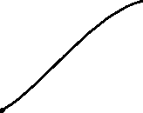
Fast Initial Step
A proposed mechanism is
Step 1: NO + Br₂
NOBr₂ (fast)
Step 2: NOBr₂ + NO ⎯⎯→ 2 NOBr (slow)
Now rate = k[NO]²[Br₂

Slide 86
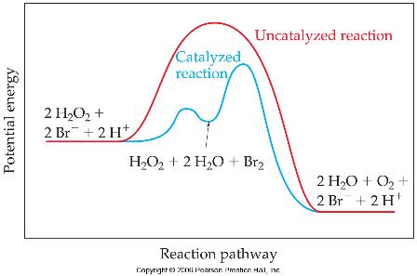
Catalysts
Catalysts increase the rate of a reaction by decreasing the activation energy of the reaction.
Catalysts change the mechanism by which the process occurs.

Slide 87
Learning Objectives
12.7 Catalysis
  Explain the function of a catalyst in terms of reaction mechanisms and potential energy diagrams
  List examples of catalysis in natural and industrial processes

Slide 88
Catalysis
Catalyst: A substance that increases the rate of a chemical reaction by lowering the activation energy without itself being consumed by the reaction.
The catalyst is regenerated in the process.
Catalysts provide an alternate reaction pathway with a lower activation energy.
Sometimes the catalyzed path contains multiple steps, but each individual step has an activation energy that is lower than the activation energy of the uncatalyzed reaction.

Slide 89
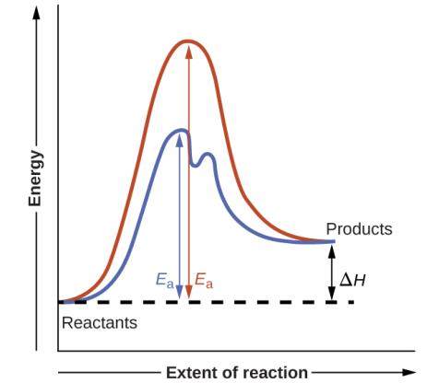
Figure 12.19
Reaction diagrams for an endothermic process in the absence (red curve) and presence (blue curve) of a catalyst. The catalyzed pathway involves a two-step mechanism (note the presence of two transition states) and an intermediate species (represented by the valley between the two transitions states).

Slide 90
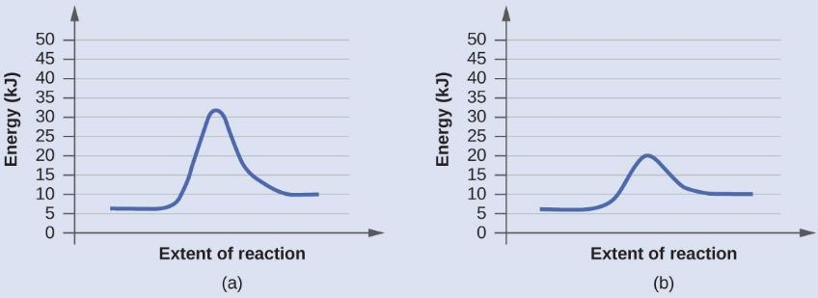
Example 12.15

Slide 91
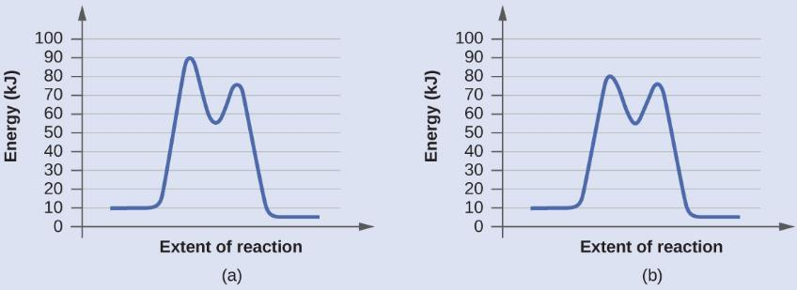
Example 12.15

Slide 92
Types of Catalysis
A homogeneous catalyst is in the same phase as the reactants. It speeds up the reaction by forming a reactive intermediate.
The reactive intermediate reacts further to form product and regenerate the catalyst.
The reactive intermediate is formed but immediately consumed.

Slide 93
Homogeneous Catalyst
Example: Chlorine radicals (Cl) that catalyze the decomposition of ozone.
Cl(g) + O₃(g) → ClO(g) + O₂(g)
ClO(g) + O(g) → Cl(g) + O₂(g)
Distinguish a catalyst from an intermediate.

Slide 94
Types of Catalysts
A heterogeneous catalyst is in a different phase from that of the reactants.
  Most commonly the catalyst is a solid and the reactants are in the gas or liquid phase.
  Example is the catalytic converter in automobiles which consists of platinum and rhodium metals.
Pt
2CO(g) + O₂(g) → CO₂(g)
Rh
NO(g) → N₂(g) + O₂(g)

Slide 95
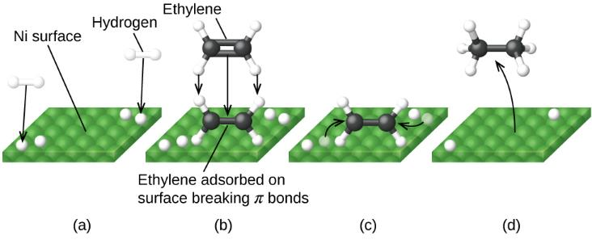
Figure 12.23
Mechanism for the Ni-catalyzed reaction C₂ H₄ + H₂ ⟶ C₂ H₆. (a) Hydrogen is adsorbed on the surface, breaking the H–H bonds and forming Ni–H bonds. (b) Ethylene is adsorbed on the surface, breaking the C–C π-bond and forming Ni–C bonds. (c) Atoms diffuse across the surface and form new C–H bonds when they collide. (d) C₂H₆ molecules desorb from the Ni surface.

Slide 96
Types of Catalysts
Enzymes are biocatalysts
  Protein molecules

Slide 97
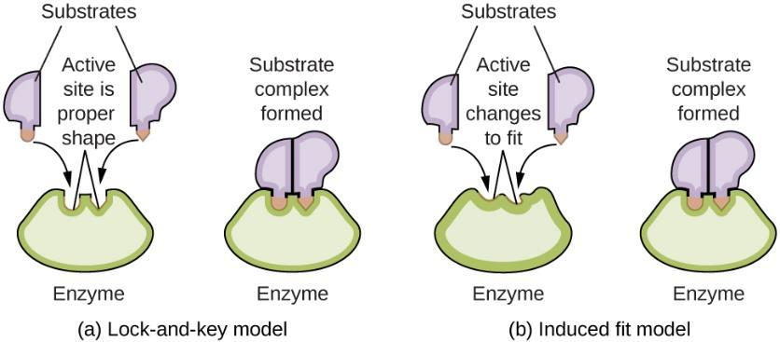
Figure 12.25
(a) According to the lock-and-key model, the shape of an enzyme’s active site is a perfect fit for the substrate. (b) According to the induced fit model, the active site is somewhat flexible, and can change shape in order to bond with the substrate.

Slide 98
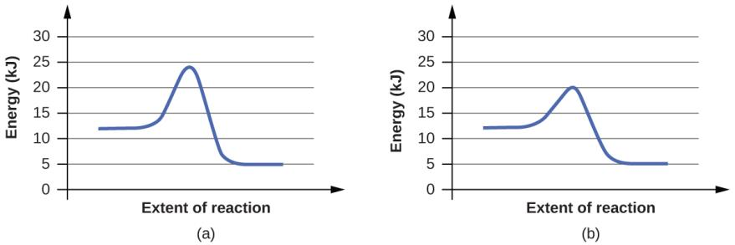
Exercise 79a

Slide 99
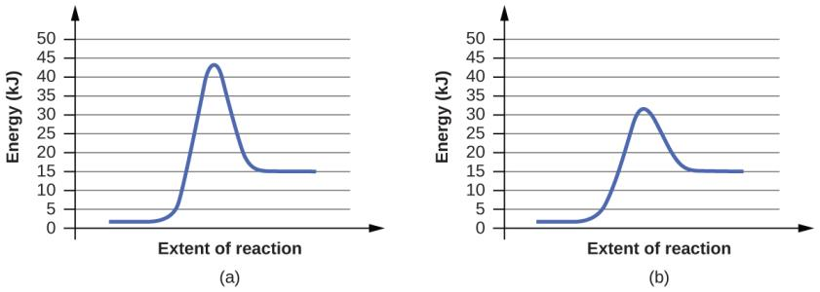
Exercise 79b

Slide 100
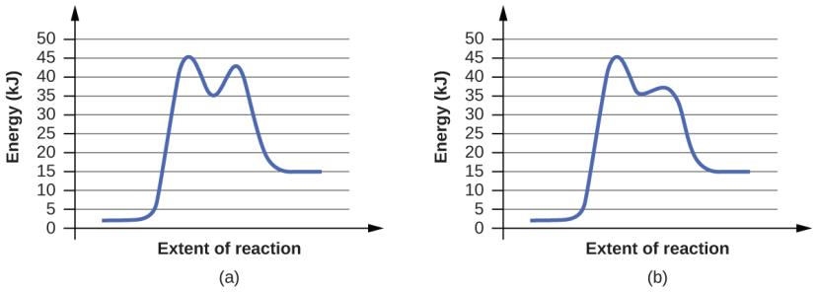
Exercise 80a

Slide 101
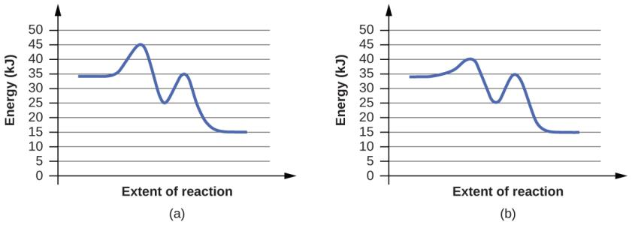
Exercise 80b

Slide 102
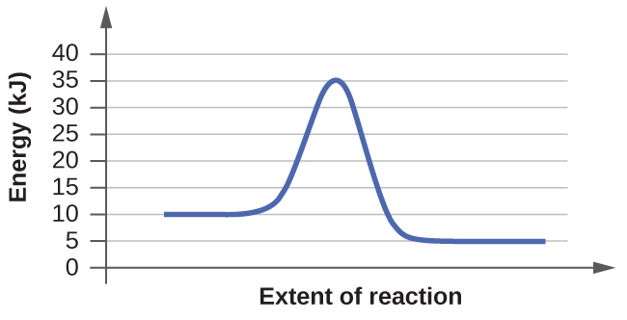
Exercise 81a

Slide 103
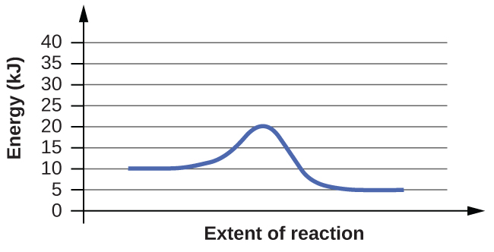
Exercise 81b

Slide 104
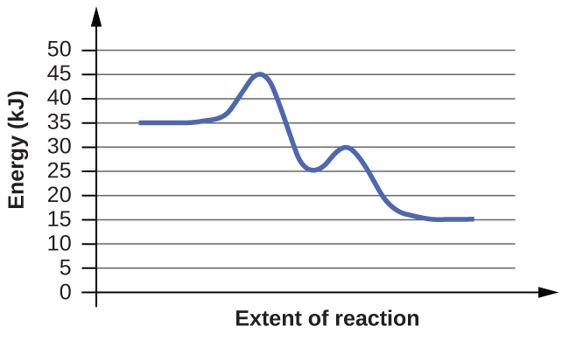
Exercise 82a

Slide 105
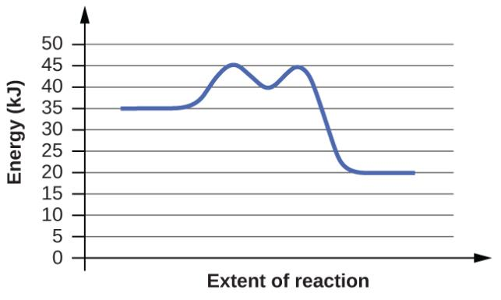
Exercise 82b

Slide 106
This OpenStax ancillary resource is © Rice University under a CC-BY 4.0 International license; it may be reproduced or modified but must be attributed to OpenStax, Rice University and any changes must be noted.

